Slide 1
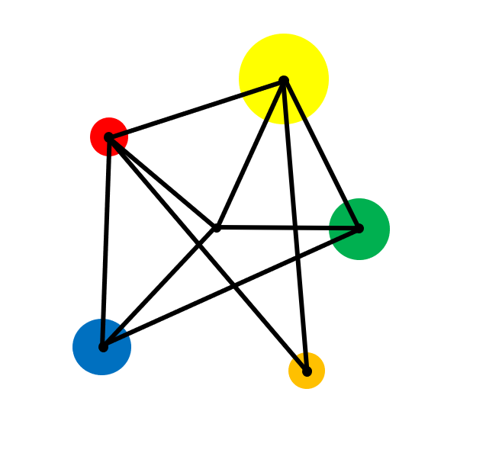
Inequalities

Slide 2
Use all four inequality signs.
Illustrate inequalities on a number line.
Solve linear inequalities.
Shade simple linear inequalities on co-ordinate axes.

Slide 3

Vocabulary
Inequality
A statement that one quantity is bigger (or smaller) than another.
Integer
A whole number.

Slide 4
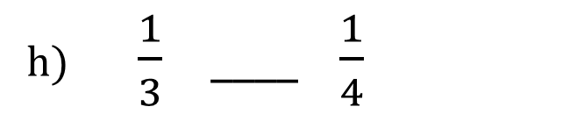
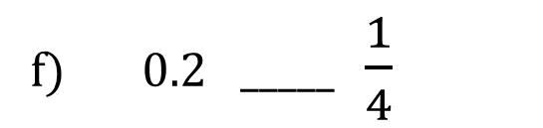
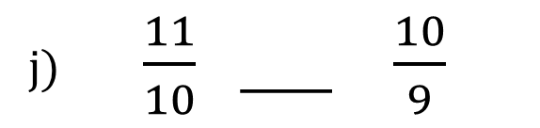
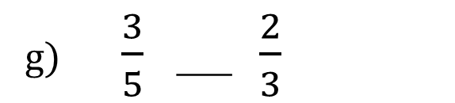
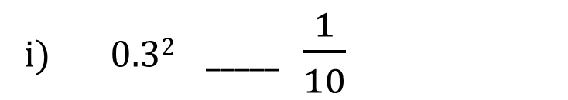
Starter
Which of the signs < , = , > should go between each pairs of numbers?
a) 3 _____ 1
b) - 1 _____ 1
c) 3² _____ 2³
d) (- 1)² _____ 1
f) 0.2 _____ $\frac{1}{4}$
e) - 7 _____ - 3
g) $\frac{3}{5}$ ___ $\frac{2}{3}$
h) $\frac{1}{3} ____$ $\frac{1}{4}$
i) 0.3² _____ $\frac{1}{10}$
j) $\frac{11}{10}$ ___ $\frac{10}{9}$

Slide 5
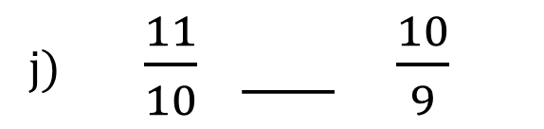
Solutions
Which of the signs < , = , > should go between each pairs of numbers?
>
<
a) 3 _____ 1
b) - 1 _____ 1
=
>
d) (- 1)² _____ 1
c) 3² _____ 2³
f) 0.2 _____ $\frac{1}{4}$
<
<
e) - 7 _____ - 3
g) $\frac{3}{5}$ ___ $\frac{2}{3}$
h) $\frac{1}{3} ____$ $\frac{1}{4}$
<
>
i) 0.3² _____ $\frac{1}{10}$
j) $\frac{11}{10}$ ___ $\frac{10}{9}$
<
<

Slide 6
Key Facts
<
>
means ‘less than’
means ‘less than or equal to’
means ‘greater than’
means ‘greater than or equal to’
≤
≥

Slide 7
Examples
Which of these statements are true?
a) 2 < 3
b) 2 ≤ 3
c) 3 > 2
d) 3 ≥ 2
e) 3 ≤ 3
e) - 3 ≤ - 3

Slide 8
Solutions
Which of these statements are true?
a) 2 < 3
True
b) 2 ≤ 3
True
c) 3 > 2
True
d) 3 ≥ 2
True
e) 3 ≤ 3
True
True
e) - 3 ≤ - 3

Slide 9
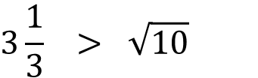


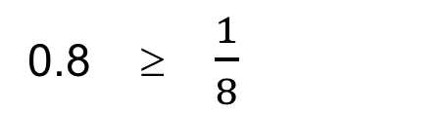

True or False
True or false?
True or false?
True or false?
1.
$$−\frac{1}{3} > \frac{1}{2}$$
1.
5 > 2
1.
0.6 > 0.21
2.
6 ≥ 4
2.
- 5 < - 7
2.
0.1² < 0.1
3.
6 ≥ 6
3.
$$\frac{1}{5} < \frac{1}{6}$$
$$\frac{5}{6} < \frac{6}{5}$$
3.
0.8 ≥ $\frac{1}{8}$
4.
-1 < - 2
4.
$$3\frac{1}{3} > \sqrt{10}$$
4.
5.
- 4 ≤ - 7
5.
3² ≤ 2³
6.
- 3 ≤ - 1

Slide 10
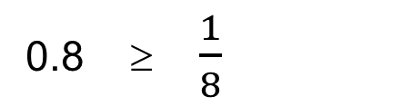
True or False
True or false?
True or false?
True or false?
1.
$$−\frac{1}{3} > \frac{1}{2}$$
False
1.
5 > 2
True
1.
0.6 > 0.21
True
2.
6 ≥ 4
True
2.
- 5 < - 7
False
2.
0.1² < 0.1
True
3.
6 ≥ 6
True
3.
$$\frac{1}{5} < \frac{1}{6}$$
$$\frac{5}{6} < \frac{6}{5}$$
False
3.
True
0.8 ≥ $\frac{1}{8}$
4.
-1 < - 2
4.
False
True
$$3\frac{1}{3} > \sqrt{10}$$
4.
True
5.
- 4 ≤ - 7
False
5.
False
3² ≤ 2³
6.
- 3 ≤ - 1
True

Slide 11

Key Fact
Inequalities can be represented on a number line:
x ≥ - 2
x
A solid circle is used to show that - 2 satisfies the inequality.

Slide 12
Example
Represent the following inequality on a number line: - 1 ≤ x < 3
x

Slide 13
Solution
Represent the following inequality on a number line: -1 ≤ x < 3
x
We use an empty circle to show that 3 is not included in the inequality.

Slide 14



You try …
Write down the inequalities shown by these number lines?
x
x
x

Slide 15
Solutions
Write down the inequalities shown by these number lines?
x < 4
x
x ≥ -2
x
-2 < x ≤ 2
x

Slide 16

Exercise
Challenge
Which is larger:
x² or x
Write down the inequalities shown on each number line:
x
x
x
x
x
x

Slide 17
Solutions
Which is larger:
x² or x
x when
0 < x < 1
Write down the inequalities shown on each number line:
x < 5
x ≤ - 1
x
x
x ≥ 0
x > -2
x
x
- 3 < x < 4
0 < x ≤ 5
x
x

Slide 18
Example
n is an integer such that
-2 ≤ n < 3
Write down all the possible values of n.

Slide 19
Solution
n is an integer such that
-2 ≤ n < 3
-3
-2
-1
0
1
2
3
The possible values of ‘n’ are : - 2 , - 1 , 0 , 1 , 2

Slide 20
Exercise
Write down the integers which satisfy each inequality:
Challenge
n is an integer that satisfies both inequalities below:
- 7 < n - 6 ≤ 1
13 < 2n + 1 ≤ 21
What is the value of n?
(a) - 2 ≤ n ≤ 2
(b) 3 ≤ n < 6
(c) -1 < n < 1
(d) - 4 ≤ n + 3 < 0
(e) 2 < 2n ≤ 10
(f) - 6 < 3n - 3 ≤ 3

Slide 21
Exercise
Write down the integers which satisfy each inequality:
Challenge
n is an integer that satisfies both inequalities below:
- 7 < n - 6 ≤ 1
13 < 2n + 1 ≤ 21
What is the value of n?
(a) - 2 ≤ n ≤ 2
(b) 3 ≤ n < 6
- 2 , -1 , 0 , 1 , 2
3 , 4 , 5
(c) -1 < n < 1
(d) - 4 ≤ n + 3 < 0
0
- 7 , - 6 , - 5 , - 4
(e) 2 < 2n ≤ 10
(f) - 6 < 3n - 3 ≤ 3
2 , 3 , 4 , 5
0 , 1 , 2
n = 7

Slide 22
Solving Linear Inequalities Example
Solve the inequalities.
a) b + 10 < 7
b) 8x ≤ 48
c) 2t + 1 > 37
d) w - 6 ≥ 7
3

Slide 23
Solutions
Solve the inequalities.
a) b + 10 < 7
b) 8x ≤ 48
b < - 3
x ≤ 6
c) 2t + 1 > 37
d) w - 6 ≥ 7
t > 18
3
w ≥ 27

Slide 24
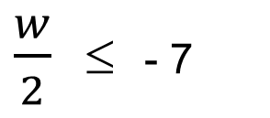
Exercise
Solve these linear inequalities
Solve these linear inequalities
Solve these linear inequalities
1.
t + 1 > 5
1.
p - 2 < 0
1.
5t + 3 > 10
2.
b - 5 < 12
2.
d + 10 ≤ 5
2.
m - 11 ≥ 11
11
3.
k + 19 ≤ 41
3.
12 - q > 8
Solve these non-linear inequalities
4.
2a ≥ 32
4.
31 ≥ 2f
1.
x² < 16
5.
10q < 420
5.
2x > x
$\frac{w}{2}$ ≤ - 7
2.
x³ > 8
6.

Slide 25
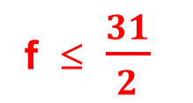
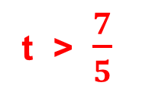
Solutions
Solve these linear inequalities
Solve these linear inequalities
Solve these linear inequalities
1.
t + 1 > 5
t > 4
1.
p - 2 < 0
p < 2
1.
5t + 3 > 10
t > $\frac{7}{5}$
2.
b - 5 < 12
b < 17
2.
d + 10 ≤ 5
d ≤ - 5
2.
m - 11 ≥ 11
11
m ≥ 132
3.
k + 19 ≤ 41
k ≤ 22
3.
12 - q > 8
q < 4
Solve these non-linear inequalities
f ≤ $\frac{31}{2}$
4.
2a ≥ 32
a ≥ 16
4.
31 ≥ 2f
1.
x² < 16
5.
10q < 420
q < 42
5.
2x > x
x > 0
- 4 < x < - 4
$\frac{w}{2}$ ≤ - 7
2.
x³ > 8
6.
w ≤ - 14
x > 2

Slide 26

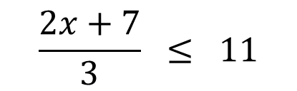
Example
Solve the inequalities.
$$\frac{2x+7}{3} ≤ 11$$
a)
b)
$$20−3x > 2x+5$$

Slide 27



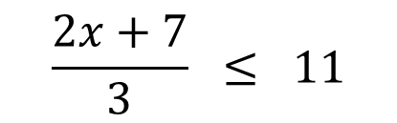




Solutions
Solve the inequalities.
a)
$$\frac{2x+7}{3} ≤ 11$$
b)
$$20−3x > 2x+5$$
+ 3x
+ 3x
x 3
x 3
$$20 > 5x+5$$
$$2x+7 ≤ 33$$
- 5
- 5
- 7
- 7
$$15 > 5x$$
$$2x ≤ 26$$
÷ 5
÷ 5
÷ 2
÷ 2
$$3 > x$$
$$x ≤13$$

Slide 28
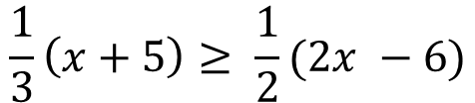
Exercise
Solve these linear inequalities
Solve these linear inequalities
Solve:
1.
3p + 5 ≤ 17
1.
57 < 3(y – 2)
$$\frac{1}{3}\left(x+5\right)≥ \frac{1}{2}(2x −6)$$
2.
64 > 16 + 6x
2.
4(r + 3) ≥ 18
3.
12 - k < 6
3.
6w – 2 ≤ 2(w + 5)
4.
3m - 7 > m + 3
4.
5(a – 1) ≥ 2(a + 5)
5.
20 – 4t ≤ 15 + t
5.
4(2 – h) < 1 – 2h
6.
2(b + 3) ≥ 30

Slide 29
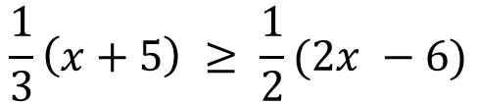
Solutions
Solve these linear inequalities
Solve these linear inequalities
Solve:
1.
3p + 5 ≤ 17
p ≤ 4
1.
57 < 3(y – 2)
y > 21
$$\frac{1}{3}\left(x+5\right) ≥ \frac{1}{2}(2x −6)$$
x ≤ 7
2.
64 > 16 + 6x
x < 8
2.
r ≥ 1.5
4(r + 3) ≥ 18
3.
12 - k < 6
k > 6
3.
6w – 2 ≤ 2(w + 5)
w ≤ 3
4.
3m - 7 > m + 3
4.
5(a – 1) ≥ 2(a + 5)
m > 5
a ≥ 5
5.
20 – 4t ≤ 15 + t
5.
4(2 – h) < 1 – 2h
t ≥ 1
h > 3.5
6.
2(b + 3) ≥ 30
b ≥ 12

Slide 30

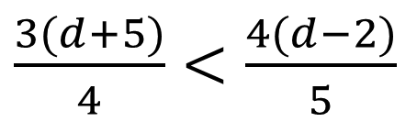




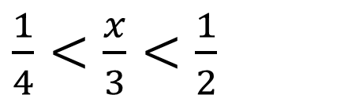
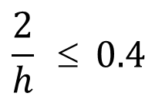
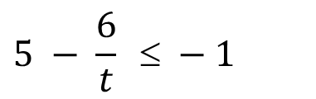
Further exercise
Solve these linear inequalities
Solve these linear inequalities
Solve these non-linear inequalities
1.
$$\frac{3m+5}{4}<−4$$
1.
$\frac{1}{4}<\frac{x}{3}<\frac{1}{2}$
1.
$$x^{2}< 25$$
$\frac{3(d+5)}{4}<\frac{4(d−2)}{5}$
$$\frac{2}{h} ≤ 0.4$$
2.
2.
2.
$$x^{2}≥ 9$$
$$5 − \frac{6}{t} ≤ −1$$
$$x^{3}≤ 8$$
3.
$$9< 2x+1  20$$
3.
3.

Slide 31
Solutions
Solve these linear inequalities
Solve these linear inequalities
Solve these non-linear inequalities
1.
$$\frac{3m+5}{4}<−4$$
1.
$\frac{1}{4}<\frac{x}{3}<\frac{1}{2}$
1.
$$x^{2}< 25$$
m < - 7
- 5 < x ≤ 5
0.75 < x < 1.5
$\frac{3(d+5)}{4}<\frac{4(d−2)}{5}$
$$\frac{2}{h} ≤ 0.4$$
2.
2.
2.
$$x^{2}≥ 9$$
x ≤ - 3 or x ≥ 3
d > 107
h ≥ 5 or h ≤ 0
$$5 − \frac{6}{t} ≤ −1$$
$$x^{3}≤ 8$$
3.
$$9< 2x+1  20$$
3.
3.
4 < x ≤ 9.5
t ≤ 1
x ≤ 2

Slide 32



Extension
Which of the following statements is true?
$$0.9 < 1$$
$$0.99999999999999 < 1$$
$$0.\dot{9} < 1$$

Slide 33
Exam Style Question
a) Solve 12n > 28 – 2n
b)
n is an integer.
-3 < n ≤ 3.
Write down all the possible values of n
c) On the number line below, show the set of values for which -8 ≤ 3n+1 < 2
-4
-3
-2
-1
0
1
2
3
4

Slide 34
Solution
a) Solve 12n > 28 – 2n
14n > 28
n > 2
b)
n is an integer.
-3 < n ≤ 3.
Write down all the possible values of n
-2 , -1 , 0 , 1 , 2 , 3
c) On the number line below, show the set of values for which -8 ≤ 3n+1 < 2
-4
-3
-2
-1
0
1
2
3
4

Slide 35
Exam Style Question
Here are two inequalities.
-1 ≤ x < 4
8 ≤ x + y ≤ 12
x and y are integers.
Work out the greatest possible value of y - x.

Slide 36
Solution
Here are two inequalities.
x = -1 , 0 , 1 , 2 , 3
-1 ≤ x < 4
We need the smallest possible value of x so x = -1
8 ≤ x + y ≤ 12
8 ≤ 3 + y ≤ 12
x and y are integers.
5 ≤ y ≤ 9
Work out the greatest possible value of y - x.
We need to use the largest possible value of y
so y = 9
x - y =
9 - -1 = 10

Slide 37
www.plexmaths.com

