Slide 1
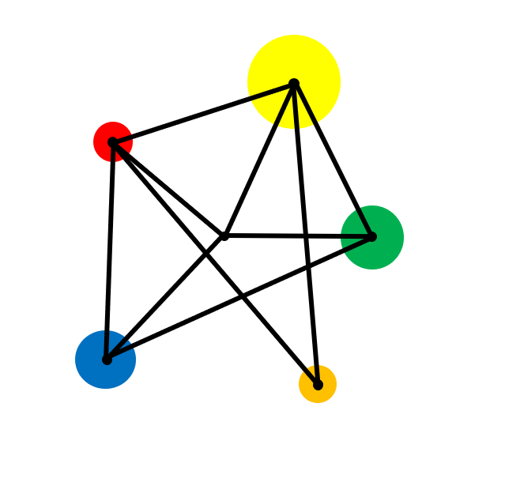
Rounding & Estimating

Slide 2
Round numbers to a given accuracy
Round numbers to a given number of decimal places
Round numbers to a given number of significant figures
Understand truncation of numbers

Slide 3
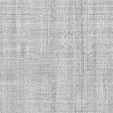
Vocabulary
Estimate (verb)
To calculate approximately.
Estimate (noun)
An approximate value.
Decimal Places
The digits to the right of the decimal point.

Slide 4
Key Facts
Sometimes we do not need all the digits of a number.
For example, the population of the world is 8,012,324,945.
We could round this to 8 000 000 000 (8 billion).
There is a special number called π which is approximately 3.1415926535.
This is often rounded to 3.14.

Slide 5
Example: Rounding to a given accuracy
Round 1984.73
a) To the nearest whole number
b) To the nearest tenth

Slide 6
Solution
Round 1984.73
a) To the nearest whole number
= 1985
b) To the nearest tenth
= 1984.7

Slide 7
Exercise
Round:
Round:
Challenge
1)
257 to the nearest 10.
1)
2.86 to the nearest tenth.
How would you round 8.5 to the nearest whole number?
2)
617 to the nearest 100.
2)
0.5768 to the nearest whole number.
3)
13.6 to the nearest whole number.
3)
98.8079 to the nearest hundredth.
4)
3579 to the nearest thousand.
4)
21.65 to the nearest 0.5.
5)
452 to the nearest 20.
5)
0.99 to the nearest tenth.
6)
1 760 to the nearest 10.

Slide 8
Solutions
Round:
Round:
Challenge
1)
257 to the nearest 10.
1)
2.86 to the nearest tenth.
How would you round 8.5 to the nearest whole number?
260
2.9
2)
617 to the nearest 100.
2)
0.5768 to the nearest whole number.
9.
Whenever we come across a 5 after the rounding position we round upwards.
600
1
3)
13.6 to the nearest whole number.
3)
98.8079 to the nearest hundredth.
14
98.81
4)
3579 to the nearest thousand.
4 000
4)
21.65 to the nearest 0.5.
21.5
5)
452 to the nearest 20.
460
5)
0.99 to the nearest tenth.
6)
1 760 to the nearest 10.
1.0
1 760

Slide 9
Example: Decimal Places
Round 3.1415926535 to:
a) 2 decimal places
b) 3 decimal places

Slide 10
Solution
Round 3.1415926535 to:
a) 2 decimal places
3.1415926535
= 3.14 (2 d.p.)
b) 3 decimal places
3.1415926535
= 3.142 (3 d.p.)
Round up if the next digit is 5 or greater.
No other digits change.

Slide 11
Exercise
Round these numbers to 2 decimal places
Round these numbers to the number of decimal places in brackets
Challenge
A number has been rounded to two decimal places.
The result is 2.4.
1.
2.3511
1.
77.8154 (3 d.p)
2.
28.141
2.
9.5555 (2 d.p)
a) What is the smallest the original number could have been?
3.
11.918
3.
9.454 (1 d.p)
4.
107. 466
b) What is the largest the original number could have been?
5.
8.405
4.
77.8154 (2 d.p)
6.
38.345
5.
7.99 (1 d.p)

Slide 12
Exercise
Round these numbers to 2 decimal places
Round these numbers to the number of decimal places in brackets
Challenge
A number has been rounded to two decimal places.
The result is 2.4.
1.
2.3511
2.35
1.
77.8154 (3 d.p)
77.815
2.
28.141
28.14
2.
9.5555 (2 d.p)
9.56
a) What is the smallest the original number could have been?
3.
11.918
11.92
3.
9.454 (1 d.p)
9.5
2.35
4.
107. 466
107.47
b) What is the largest the original number could have been?
5.
8.41
4.
77.8154 (2 d.p)
77.82
8.405
6.
38.345
38.35
5.
7.99 (1 d.p)
8.0
Up to but not including 2.45

Slide 13
Example: Significant Figures
Round 3.1415926535 to 4 significant figures
Round 8,245,491 to 3 significant figures

Slide 14
Solutions
Round 3.1415926535 to 4 significant figures
3.1415926535
= 3.142 (2 s.f.)
Round 8,245,491 to 3 significant figures
8,245,491
= 8,250,000 (3 s.f.)

Slide 15
Exercise
Round these numbers to 3 significant figures.
Round these numbers to the number of significant figures in brackets.
Challenge
The sides of this rectangle have been rounded to 1 significant figure.
1)
16.428
1)
16 789
(3 s.f.)
2)
19,882
6m
2)
0.00709
(2 s.f.)
2m
3)
0.7619
3)
899 899
(2 s.f.)
4)
325,010
What is the largest value that the area of the rectangle could have taken?
4)
99
(1 s.f.)
5)
12.091
5)
8.499
(1 s.f.)
6)
154.59

Slide 16
Solutions
Round these numbers to 3 significant figures.
Round these numbers to the number of significant figures in brackets.
Challenge
The sides of this rectangle have been rounded to 1 significant figure.
1)
16.428
16.4
1)
16 789
(3 s.f.)
2)
19,882
19 900
16 800
6m
2)
0.00709
(2 s.f.)
2m
3)
0.7619
0.762
0.0071
3)
899 899
(2 s.f.)
4)
325,010
325 000
900 000
What is the largest value that the area of the rectangle could have taken?
4)
99
(1 s.f.)
100
5)
12.091
12.1
16.25m²
5)
8.499
(1 s.f.)
8
6)
154.59
155

Slide 17
Example: Truncation
Truncate 3.1415926535 after:
a) 2 decimal places
b) 3 decimal places

Slide 18
Solutions
Truncate 3.1415926535 after:
a) 2 decimal places
3.14
b) 3 decimal places
3.141

Slide 19
You try…
(a) Truncate 2 342 653 after the thousands digit.
(b) Truncate 4.293 after the units digit.
(c) Truncate 16.09475 after the 2nd decimal place.

Slide 20
Solutions
(a) Truncate 2 342 653 after the thousands digit.
2 342 000
(b) Truncate 4.293 after the units digit.
4
(c) Truncate 16.09475 after the 2nd decimal place.
16.09

Slide 21
Extension
A number is rounded to 2 decimal places.
The result is then rounded to 1 decimal place.
The final answer is 4.8.
What could the original number have been?

Slide 22
Solution
A number is rounded to 2 decimal places.
The result is then rounded to 1 decimal place.
The final answer is 4.8.
What could the original number have been?
Any number from 4.745 up to (but not including) 4.845

Slide 23
Exam Style Question
a) Write 12.55 to the nearest whole number
b) Write 3664 to the nearest hundred.
c) Write 2.68 correct to 1 decimal place
d) Write 78.49 to 2 significant figures

Slide 24
Solution
a) Write 12.55 to the nearest whole number
13
b) Write 3664 to the nearest hundred.
3700
c) Write 2.68 correct to 1 decimal place
2.7
d) Write 78.49 to 2 significant figures
78

