Slide 1
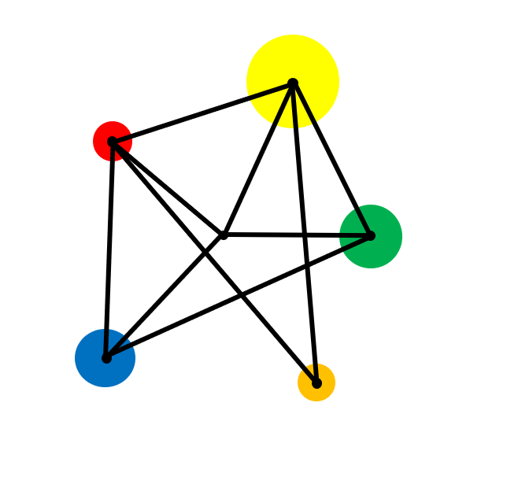
Order of Operations

Slide 2
Carry out calculations in the correct order

Slide 3

Vocabulary
Operation
A mathematical process that is applied to numbers.
These include addition, subtraction, multiplication and division as well as powers, roots and many more.
Priority
The order in which things are chosen to be done.

Slide 4
Addition and Subtraction
1 + 2 - 3 + 4 - 5
Find the value of:

Slide 5
Addition and Subtraction
Work from left to right, performing each calculation one at a time.
1 + 2 - 3 + 4 - 5
= 3

Slide 6
Mixed Calculations Example
Find the value of :
1 + 2 x 3

Slide 7
Solution
1 + 2 x 3 = 7
This is because there is an order in which we must carry out calculations.

Slide 8
Key Facts
In mathematics, there is an order in which we must carry out calculations.
Multiplication & Division
1 + 2 x 3
before
= 1 + 6
Addition & Subtraction
= 7

Slide 9



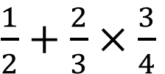










Exercise
Evaluate:
Evaluate:
Evaluate:
1)
$1+3×5$
1)
$1+2×3+4$
1)
$1+2÷0.1$
2)
$2+5×3$
2)
$10+10×10÷10$
2)
$1÷2+0.1$
3)
$9−6÷2$
3)
3)
$\frac{1}{2}+\frac{2}{3}×\frac{3}{4}$
$8−6÷2+1$
4)
$4÷4−1$
4)
$2×3×4$
5)
$10−5−2$
5)
$10−8÷2$

Slide 10



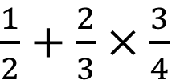











Solutions
Evaluate:
Evaluate:
Evaluate:
1)
$1+3×5$
= 16
1)
$1+2×3+4$
= 11
1)
$1+2÷0.1$
= 21
2)
$2+5×3$
= 17
2)
$10+10×10÷10$
= 11
2)
$1÷2+0.1$
= 0.6
3)
$9−6÷2$
= 6
3)
$8−6÷2+1$
3)
$\frac{1}{2}+\frac{2}{3}×\frac{3}{4}$
= 6
$$=1$$
4)
$4÷4−1$
= 0
4)
$2×3×4$
= 24
5)
$10−5−2$
= 3
5)
$10−8÷2$
= 6

Slide 11
Key Facts
If there is an expression with indices (powers), this takes priority over multiplication and division.
Indices
before
Multiplication & Division
before
Addition & Subtraction

Slide 12

Example
Evaluate:
$$1+5×3^{2}$$

Slide 13




Solution
$$1+5×3^{2}$$
$$=1+5×9$$
$$=1+45$$
$$= 46$$

Slide 14

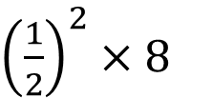






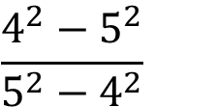



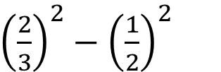
Exercise
Evaluate:
Evaluate:
Evaluate:
1)
$3+4^{2}$
1)
$12−5^{2}$
${\left(\frac{2}{3}\right)}^{2}−{\left(\frac{1}{2}\right)}^{2}$
1)
2)
$5^{2}×4$
2)
$4÷2^{3}$
3)
$4−1^{2}$
3)
$$6−{\left(−1\right)}^{2}$$
$$\frac{4^{2}−5^{2}}{5^{2}−4^{2}}$$
2)
4)
$$3^{2}×2^{3}$$
4)
$$9−{\left(−2\right)}^{3}$$
5)
$12+4×3^{2}$
${\left(\frac{1}{2}\right)}^{2}×8$
5)

Slide 15







Solutions
Evaluate:
Evaluate:
Evaluate:
1)
$3+4^{2}$
1)
$12−5^{2}$
= - 13
= 19
${\left(\frac{2}{3}\right)}^{2}−{\left(\frac{1}{2}\right)}^{2}$
= $\frac{7}{36}$
1)
= $\frac{1}{2}$
2)
$5^{2}×4$
2)
$4÷2^{3}$
= 100
3)
$4−1^{2}$
3)
$$6−{\left(−1\right)}^{2}$$
= 5
= 3
$$\frac{4^{2}−5^{2}}{5^{2}−4^{2}}$$
2)
= - 1
4)
$$3^{2}×2^{3}$$
= 72
4)
$$9−{\left(−2\right)}^{3}$$
= 17
5)
${\left(\frac{1}{2}\right)}^{2}×8$
5)
$12+4×3^{2}$
= 48
= 2

Slide 16
Key Facts
If there is an expression in brackets, this takes priority over indices, multiplication and division.
Brackets
before
Indices
before
Multiplication & Division
before
Addition & Subtraction
This means that addition and subtraction can take place before multiplication and division. Can you see how?

Slide 17




Example
Evaluate:
$$a)$$
$$(1+2)×3$$
$$b)$$
$$\left(5+6\right)×{(9−4)}^{2}$$

Slide 18








Solutions
Evaluate:
$$a)$$
$$(1+2)×3$$
$$b)$$
$$\left(5+6\right)×{(9−4)}^{2}$$
$$=3×3$$
$$=11×5^{2}$$
$$=9$$
$$=11×25$$
$$=275$$

Slide 19



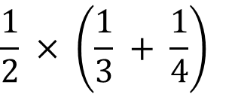






Exercise
Evaluate:
Evaluate:
Use the numbers 1, 2, 3 and 4 and + , - , x , ÷ and brackets to make the numbers 1 to 16.
i.e. (2 – 1) x (3 + 4) = 7
You must use all the numbers but each one only once.
1)
$$(2+3)×4$$
1)
$$(0.3+0.9)×10$$
2)
$$(46−9)÷7$$
2)
$${(1+2^{2})}^{3}$$
3)
$${(3+5)}^{2}$$
3)
$${(−6+2×1)}^{2}$$
4)
$$(5+2)×(5−2)$$
$$\frac{1}{2} × \left(\frac{1}{3} + \frac{1}{4}\right)$$
5)
$$6+2×(4−1)$$
4)

Slide 20
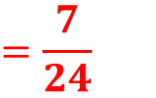
Exercise
Evaluate:
Evaluate:
(2 – 1) x (4 - 3) = 1
2 + 3 – 4 + 1 = 2
(2 + 1) x (4 – 3) = 3
1 + 2 – 3 + 4 = 4
(4 + 1) x (2 – 1) = 5
1 – 2 + 3 + 4 = 6
(2 – 1) x (3 + 4) = 7
(2 – 1) x (3 + 4) = 7
(4 – 2) x (3 + 1) = 8
(2 + 3 + 4) x 1 = 9
1 + 2 + 3 + 4 = 10
4 x 3 - 2 + 1 = 11
4 x 3 x (2 – 1) = 12
4 x 3 + 2 – 1 = 13
(4 x 3 + 2) x 1 = 14
4 x 3 + 2 + 1 = 15
4 x 2 x (3 – 1) = 16
1)
$$(2+3)×4$$
= 20
1)
$$(0.3+0.9)×10$$
= 12
2)
$$(46−9)÷7$$
= 5
2)
$${(1+2^{2})}^{3}$$
= 125
3)
$${(3+5)}^{2}$$
= 64
3)
$${(−6+2×1)}^{2}$$
= 16
4)
$$(5+2)×(5−2)$$
= 21
$$\frac{1}{2} × \left(\frac{1}{3} + \frac{1}{4}\right)$$
$$=\frac{7}{24}$$
5)
$$6+2×(4−1)$$
= 12
4)

Slide 21
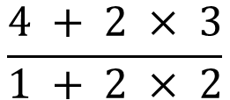
Extra
Be careful of division signs written like this:
$$\frac{4 + 2 × 3}{1 + 2 × 2}$$

Slide 22

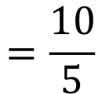
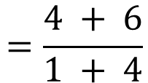
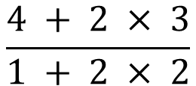
Extra
Evaluate the numerator and the denominator and then perform the division.
$$\frac{4 + 2 × 3}{1 + 2 × 2}$$
$$=\frac{4 + 6}{1 + 4}$$
$$=\frac{10}{5}$$
$$=2$$

Slide 23


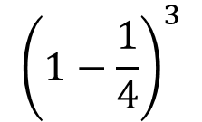





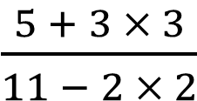



Mixed Exercise
Evaluate:
Evaluate:
Evaluate:
1)
$5+2×5$
1)
$5÷(9−7)$
1)
$(5÷(1+1))^{2}$
2)
$15÷2+1$
2)
$30−2^{3}×3$
$${\left(1−\frac{1}{4}\right)}^{3}$$
2)
3)
$2+2^{2}$
$\frac{5 + 3 × 3}{11 − 2 × 2}$
3)
4)
$4×(3+2)$
4)
$$(4−9)^{2}$$
5)
$$(9−3)^{2}$$

Slide 24
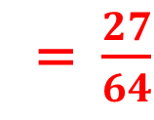
Solutions
Evaluate:
Evaluate:
Evaluate:
1)
$5+2×5$
= 15
1)
$5÷(9−7)$
= 2.5
1)
$(5÷(1+1))^{2}$
= 6.25
2)
$15÷2+1$
= 8.5
2)
$30−2^{3}×3$
= 6
$${\left(1−\frac{1}{4}\right)}^{3}$$
= $\frac{27}{64}$
2)
3)
= 6
$2+2^{2}$
$\frac{5 + 3 × 3}{11 − 2 × 2}$
3)
= 2
4)
$4×(3+2)$
= 20
4)
$$(4−9)^{2}$$
= 25
5)
$$(9−3)^{2}$$
= 36

Slide 25

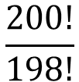
Investigation – a new operation
In mathematics, the operation ‘!’ is called factorial.
4! means 1 x 2 x 3 x 4
Find the
x!
key on your calculator and use it to evaluate 5!
Evaluate:
a)
10!
$$\frac{6!}{5!}$$
$$\frac{200!}{198!}$$
b)
c)
Find the last digit of 200!

Slide 26
Exam Style Question
Tia is playing a game with number tiles.
She is trying to put down tiles to make two calculations with the same answer
Here is what Tia put down.
4
-
3
x
2
=
4
-
2
Is she correct?
Show how you made your decision.

Slide 27
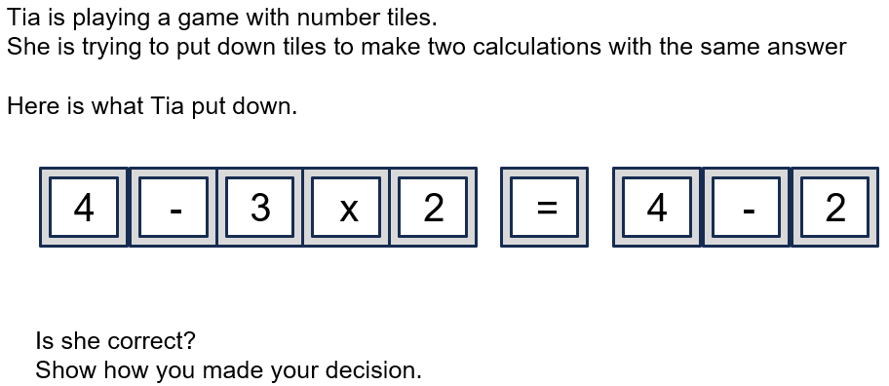
Solution
Tia is not correct.
4 – 3 x 2 = -2 but 4 – 2 = 2

