Slide 1
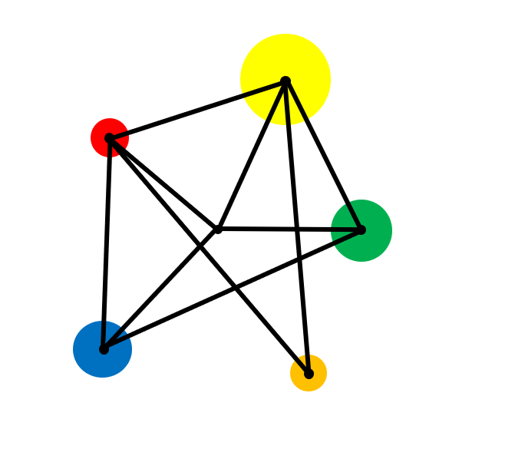
Negative Numbers

Slide 2
Add, subtract, multiply & divide positive and negative numbers

Slide 3
Vocabulary
Negative Number
A number having a value less than zero.

Slide 4
Key Fact
We use a number line to order positive and negative numbers..
A number is greater than another if it lies to the right of it..

Slide 5
Example
True or false?
a)
3 > - 2
b)
- 4 < - 7

Slide 6
Solutions
True or false?
3 > - 2
True
- 4 < - 7
False

Slide 7
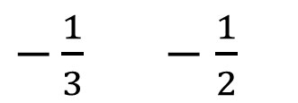
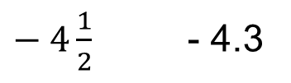
Exercise
Insert one of the symbols > or < between each of the numbers.
Insert one of the symbols > or < between each of the numbers.
Write down three numbers that are greater than - 1 but less than 0.
a)
6 4
a)
- 3.5 - 3
b)
4 8
b)
$− 4\frac{1}{2}$ - 4.3
c)
2 0
c)
$−\frac{1}{3} −\frac{1}{2}$
d)
- 1 6
e)
- 9 - 5

Slide 8
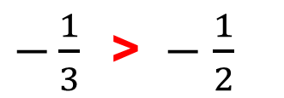
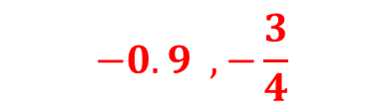

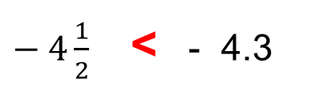
Solutions
Insert one of the symbols > or < between each of the numbers.
Insert one of the symbols > or < between each of the numbers.
Write down three numbers that are greater than -1 but less than 0.
a)
6 > 4
a)
- 3.5 < - 3
$For example…$
$$−0.9 , −\frac{3}{4}$$
b)
4 < 8
b)
$− 4\frac{1}{2}$ < - 4.3
c)
2 > 0
c)
$−\frac{1}{3} \text{>} −\frac{1}{2}$
d)
- 1 < 6
e)
- 9 < - 5

Slide 9
Key Fact
Addition of a positive number moves to the right along the number line.
- 10 + 4 = ?
- 3 + 6 = ?
5 + 4 = ?

Slide 10
Key Fact
Addition of a positive number moves to the right along the number line.
- 10 + 4 = - 6
- 3 + 6 = 3
5 + 4 = 9

Slide 11


Addition of positive numbers
Evaluate:
Evaluate:
Evaluate:
1)
5 + 4
1)
25 + 16
1)
- 2.5 + 0.9
2)
4 + 5
2)
16 + 25
2)
- 10 + 4 + 4
3)
3)
3 + 0
3)
- 16 + 25
4)
4)
- 1 + 6
4)
- 25 + 16
5)
- 9 + 4
5)
- 1.6 + 2.5
6)
- 7 + 7

Slide 12
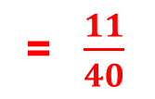
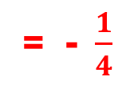
Solutions
Evaluate:
Evaluate:
Evaluate:
1)
5 + 4
= 9
1)
25 + 16
= 41
1)
- 2.5 + 0.9
= - 1.6
2)
4 + 5
= 9
2)
16 + 25
= 41
2)
- 10 + 4 + 4
= - 2
= -$\frac{1}{4}$
3)
3)
3 + 0
= 3
3)
- 16 + 25
= 9
= $\frac{11}{40}$
4)
4)
- 1 + 6
= 5
4)
- 25 + 16
= - 9
5)
- 9 + 4
= - 5
5)
- 1.6 + 2.5
= 0.9
6)
- 7 + 7
= 0

Slide 13

Key Fact
Subtraction of a positive number moves us to the left along the number line.
-6 - 4 = ?
2 - 5 = ?
9 - 3 = ?

Slide 14
Key Fact
Subtraction of a positive number moves us to the left along the number line.
-6 - 4 = - 10
2 - 5 = - 3
9 - 3 = 6

Slide 15
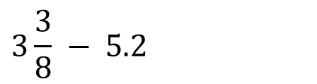
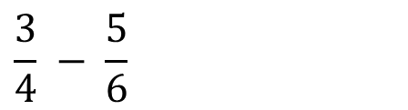
Subtraction of positive numbers
Evaluate:
Evaluate:
Evaluate:
1)
15 - 12
1)
11 - 19
1)
49 – 100
2)
12 - 15
2)
0 - 8
2)
8.1 – 12.11
3)
6 - 0
3)
5 – 9.6
3)
8 – 9 – 10
$$\frac{3}{4} − \frac{5}{6}$$
4)
8 - 9
4)
-12 – 9
4)
5)
11 - 15
5)
1.1 – 5.2
$$3\frac{3}{8} − 5.2$$
5)
6)
-1 - 8

Slide 16
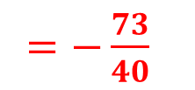
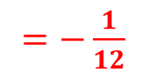
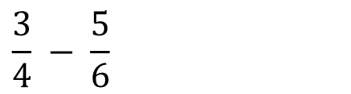
Solutions
Evaluate:
Evaluate:
Evaluate:
15 - 12
= 3
11 - 19
= - 8
= - 51
1)
1)
1)
49 – 100
2)
12 - 15
= - 3
2)
0 - 8
2)
8.1 – 12.11
= - 8
= - 4.01
3)
6 - 0
= 6
3)
5 – 9.6
3)
8 – 9 – 10
= - 4.6
= - 11
$$\frac{3}{4} − \frac{5}{6}$$
4)
8 - 9
= - 1
4)
-12 – 9
= - 21
4)
$=−\frac{1}{12}$
$$3\frac{3}{8} − 5.2$$
5)
11 - 15
= - 4
5)
1.1 – 5.2
= - 4.1
5)
$=−\frac{73}{40}$
= - 1.825
6)
-1 - 8
= - 9

Slide 17
Key Fact
Addition of a negative number moves us to the left along the number line.
This is the same as subtraction of a positive number.
- 6 + - 3 = ?
0 + - 3 = ?
8 + - 4 = ?

Slide 18
Key Fact
Addition of a negative number moves us to the left along the number line.
This is the same as subtraction of a positive number.
- 6 + - 3 = - 9
0 + - 3 = - 3
8 + - 4 = 4

Slide 19
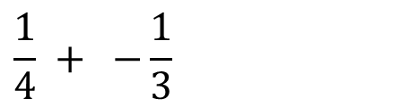
Addition of negative numbers
Evaluate:
Evaluate:
Evaluate:
1)
6 + - 4
1)
10 + - 6
1.
0.1 + - 1
2)
12 + - 8
2)
6 + - 10
2.
- 2 + - 3 + - 4
$$\frac{1}{4} + −\frac{1}{3}$$
3.
3)
12 + - 12
3)
- 6 + - 10
4)
5 + - 7
4)
-10 + - 6
5)
0 + - 5
5)
-16 + - 19
6)
- 6 + - 8
6)
- 1.9 + - 0.9

Slide 20
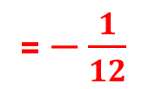
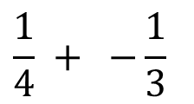
Solutions
Evaluate:
Evaluate:
Evaluate:
1)
6 + - 4
= 2
1)
10 + - 6
= 4
1.
0.1 + - 1
= - 0.9
2)
12 + - 8
= 4
2)
6 + - 10
= - 4
2.
- 2 + - 3 + - 4
= - 9
$$\frac{1}{4} + −\frac{1}{3}$$
3.
12 + - 12
= - 16
3)
= 0
3)
- 6 + - 10
4)
5 + - 7
4)
= - 16
= - 2
-10 + - 6
5)
0 + - 5
= - 5
5)
-16 + - 19
= - 35
6)
- 6 + - 8
= - 14
6)
- 1.9 + - 0.9
= - 2.8

Slide 21
Key Fact
Subtraction of a negative number moves us to the right along the number line.
This is the same as addition of a positive number.
- 9 - - 10 = ?
3 - - 6 = ?

Slide 22
Key Fact
Subtraction of a negative number moves us to the right along the number line.
This is the same as addition of a positive number.
- 9 - - 10 = 1
3 - - 6 = 9

Slide 23
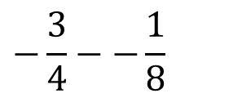
Subtraction of negative numbers
Evaluate:
Evaluate:
Evaluate:
1)
3 - - 4
1)
12 - - 16
1)
-1 - - 2 - - 3
$$−\frac{3}{4}−−\frac{1}{8}$$
2)
8 - - 1
2)
16 - - 12
2)
3)
0 - - 2
3)
- 16 - - 12
4)
- 8 - - 2
4)
- 12 - - 16
5)
- 5 - - 6
5)
- 1.2 - - 1.6
6)
- 4 - - 4
6)
- 1.6 - - 1.2

Slide 24
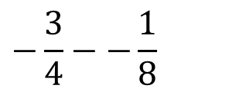
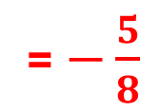
Solutions
Evaluate:
Evaluate:
Evaluate:
1)
3 - - 4
= 7
= 28
= 4
1)
12 - - 16
1)
-1 - - 2 - - 3
$$−\frac{3}{4}−−\frac{1}{8}$$
= $−\frac{5}{8}$
2)
8 - - 1
= 9
2)
16 - - 12
2)
= 28
3)
0 - - 2
= 2
3)
- 16 - - 12
= - 4
4)
- 8 - - 2
4)
= 4
= - 6
- 12 - - 16
5)
- 5 - - 6
= 1
5)
- 1.2 - - 1.6
= 0.4
6)
- 4 - - 4
= 0
6)
- 1.6 - - 1.2
= - 0.4

Slide 25
Mixed addition and subtraction.
Evaluate:
1.
7 - 4
2.
3 - 6
3.
- 6 + 3
4.
9 + 13
5.
- 9 + 0
6.
-1 + 7
7.
-5 - 4
8.
- 6 + 8
9.
0 - 13
10.
-1 - 9
11.
20 - - 9
12.
- 11 – (+ 11)
13.
7 + - 5
14.
4 - + 6
15.
- 4 - - 7
16.
-1 + 2 - 3

Slide 26
Solutions
Evaluate:
1.
7 - 4
= 3
2.
3 - 6
= - 3
3.
- 6 + 3
= - 3
4.
9 + 13
= 22
5.
- 9 + 0
= - 9
6.
-1 + 7
= 6
7.
-5 - 4
= - 9
8.
- 6 + 8
= 2
9.
0 - 13
= - 13
10.
-1 - 9
= - 10
11.
20 - - 9
= 29
12.
- 11 – (+ 11)
= - 22
13.
7 + - 5
= 2
14.
4 - + 6
= - 2
15.
- 4 - - 7
= 3
16.
-1 + 2 - 3
= - 2

Slide 27
Multiplication and Division
Multiplication and division follows the rules below.
x | + | -
+ | + | -
- | - | +
÷ | + | -
+ | + | -
- | - | +

Slide 28
Multiplying & Dividing Negative Numbers: Examples
a)
3 x - 4
b)
8 ÷ - 2
c)
- 5 x - 6
d)
- 35 ÷ - 5
e)
( - 5) ²

Slide 29
Solutions
a)
3 x - 4
b)
8 ÷ - 2
= - 12
= - 4
c)
- 5 x - 6
d)
- 35 ÷ - 5
= 30
= 7
e)
( - 5) ²
= 25

Slide 30
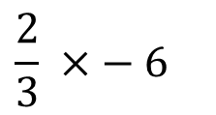
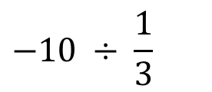
Multiplication of negative numbers
Evaluate:
Evaluate:
Evaluate:
1)
2 x - 3
1)
- 0.5 x 0.5
1)
(-2)¹⁰
2)
- 10 ÷ 2
2)
- 4 ÷ - 0.2
2)
(-1)¹⁰⁰⁰
3)
- 5 x 7
3)
( - 10)²
4)
- 16 ÷ - 2
4)
( - 2)³
5)
- 45 x - 4
5)
$$\frac{2}{3} ×− 6$$
$$−10 ÷ \frac{1}{3}$$
6)
12 ÷ - 1
6)

Slide 31

Solutions
Evaluate:
Evaluate:
Evaluate:
1)
2 x - 3
1)
- 0.5 x 0.5
= 1024
= - 6
= - 0.25
1)
(-2)¹⁰
2)
- 10 ÷ 2
= - 5
2)
- 4 ÷ - 0.2
= 20
2)
(-1)¹⁰⁰⁰
= $1$
- 5 x 7
3)
( - 10)²
3)
= - 35
= 100
4)
- 16 ÷ - 2
= 8
4)
( - 2)³
= - 8
5)
- 45 x - 4
= 180
5)
$$\frac{2}{3} ×− 6$$
= - 4
$$−10 ÷ \frac{1}{3}$$
6)
12 ÷ - 1
= - 12
6)
- 30

Slide 32
Mixed Exercise
1)
12 + - 5
2)
- 3 x - 6
3)
6 - - 8
4)
- 35 ÷ 5
5)
- 7 + 12
6)
10 + - 10
7)
- 8 ÷ - 1
8)
- 1 - - 1
9)
- 9 + - 8
10)
- 4 x - 1
11)
- 5 - 6
12)
(- 4)²
13)
4 ÷ - 0.5
14)
- 7 x - 8
15)
(- 11)²
16)
100 + - 200
17)
- 2 x - 1 x - 3
18)
(– 1) ⁵
19.)
2 + - 3 x 4
20)
(- 5)⁴

Slide 33
Mixed Exercise
1)
12 + - 5
2)
- 3 x - 6
3)
6 - - 8
4)
- 35 ÷ 5
5)
- 7 + 12
= 7
= 18
= 14
= - 7
= 5
6)
10 + - 10
7)
- 8 ÷ - 1
8)
- 1 - - 1
9)
- 9 + - 8
10)
- 4 x - 1
= 0
= 8
= 0
= - 17
= 4
11)
-5 - 6
12)
(- 4)²
13)
4 ÷ - 0.5
14)
- 7 x - 8
15)
(- 11)²
= - 11
= 16
= - 8
= 56
= 121
16)
100 + -200
17)
- 2 x - 1 x -3
18)
(– 1) ⁵
19.)
2 + - 3 x 4
20)
(- 5)⁴
= - 100
= - 6
= - 1
= - 10
= 625

Slide 34





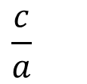



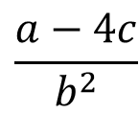









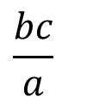
$$a = 2 , b = − 3 , c =− 4$$
Evaluate the following expressions without a calculator.
$$\frac{c}{a}$$
1)
2)
3)
$$b+c$$
$$a+b$$
$$b−a$$
3
$$ab$$
4)
5)
6)
$$ca$$
7)
$$a^{3}$$
8)
$$3^{a}$$
9)
$$bca$$
10)
$$a^{2}+b^{2}$$
11)
$$a−2c$$
12)
$$cb−a$$
13)
$$b−ac$$
14)
c$(b+2a)$
15)
$$ac^{2}$$
$$\sqrt{b^{2}+c^{2}}$$
$$\frac{bc}{a}$$
$$\frac{a−4c}{b^{2}}$$
16)
17)
$$10^{2a}$$
18)
19.)
$${2b}^{2}$$
20)

Slide 35








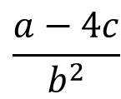









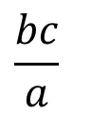
$$a = 2 , b = − 3 , c =− 4$$
Evaluate the following expressions without a calculator.
1)
$$a+b$$
= - 1
2)
$$b−a$$
= - 5
3
$$\frac{c}{a}$$
3)
$$ab$$
= - 6
4)
= - 2
5)
$$b+c$$
= - 7
6)
$$ca$$
= - 8
7)
$$a^{3}$$
= 8
8)
$$3^{a}$$
= 9
9)
$$bca$$
= 24
10)
$$a^{2}+b^{2}$$
= 13
11)
$$a−2c$$
= 10
12)
$$cb−a$$
= 10
13)
$$b−ac$$
= 5
14)
$$c(b+2a)$$
15)
$$ac^{2}$$
= 32
= - 4
$$\sqrt{b^{2}+c^{2}}$$
$$\frac{bc}{a}$$
$$\frac{a−4c}{b^{2}}$$
16)
= 5
17)
$$10^{2a}$$
18)
= 6
19.)
$${2b}^{2}$$
= 18
20)
= 2
= 10 000

Slide 36








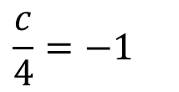



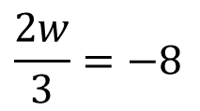



Solve the following equations.
$$\frac{c}{4}=−1$$
1)
$$a+6=4$$
2)
$$x−12=−6$$
3)
$$2b=−10$$
4)
$$m+8=1$$
$$t−8=−4$$
7)
$$\frac{2w}{3}=−8$$
5)
6)
$$3p=−21$$
8)
9)
$$10−e=13$$
10)
$$2k+1=9$$
11)
$$3z−3=−3$$
12)
$$14=10 −2h$$
13)
$$6=8+m$$
14)
$$2q=−11$$
15)
$$5f=f−7$$
16)
$$x^{2}=81$$

Slide 37


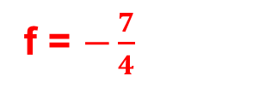
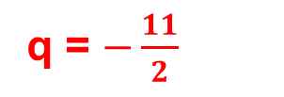

Solve the following equations.
$$\frac{c}{4}=−1$$
1)
$$a+6=4$$
2)
$$x−12=−6$$
3)
$$2b=−10$$
4)
a = - 2
x = 6
b = - 5
c = - 4
$$m+8=1$$
$$t−8=−4$$
7)
$$\frac{2w}{3}=−8$$
5)
6)
$$3p=−21$$
8)
m = -7
t = 4
p = - 7
w = - 12
9)
$$10−e=13$$
10)
$$2k+1=9$$
11)
$$3z−3=−3$$
12)
$$14=10 −2h$$
e = - 3
k = 4
z = 0
h = - 2
13)
$$6=8+m$$
14)
$$2q=−11$$
15)
$$5f=f−7$$
16)
$$x^{2}=81$$
m = - 2
q = $−\frac{11}{2}$
f = $−\frac{7}{4}$
x = ± 9

Slide 38
Extension
In order to solve the equation x + 10 = 5, we need to use the negative number -5.
What happens when you try to solve the equation x² = - 1 ?

Slide 39
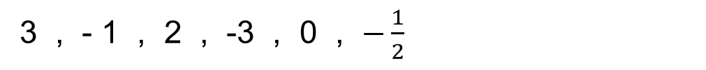
Exam Style Question
Write the following numbers in order of size.
Start with the smallest number.
3 , - 1 , 2 , -3 , 0 , $−\frac{1}{2}$
P = 5x – 2y
Work out the value of P when x = 4 and y = -3

Slide 40
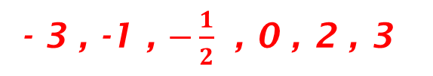
Solution
Write the following numbers in order of size.
Start with the smallest number.
3 , - 1 , 2 , -3 , 0 , $−\frac{1}{2}$
- 3 , -1 , $−\frac{1}{2}$ , 0 , 2 , 3
P = 5x – 2y
Work out the value of P when x = 4 and y = -3
P = 5 x 4 - 2 x (- 3)
= 20 - - 6
= 26

