Slide 1
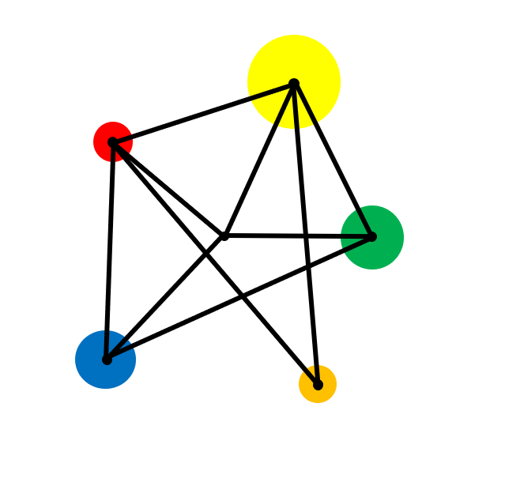
Place Value

Slide 2
Vocabulary
Decimal Point
A dot that separates the whole part of a number from the fractional part.
Decimal Place
The position of a digit to the right of the decimal point.

Slide 3
Understand numbers written in words and digits
Understand place value
Order decimals

Slide 4
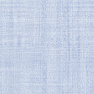
Starter
Write these numbers in digits.
a)
Three thousand and forty-six.
b)
One hundred and fifty thousand.
c)
One million, one thousand, two hundred and nine.

Slide 5
Solution
Write these numbers in digits.
a)
Three thousand and forty six.
3 046
b)
150 000
One hundred and fifty thousand.
1 001 209
c)
One million, one thousand, two hundred and nine.
M | Hth | Tth | Th | H | T | O
 |  |  | 3 | 0 | 4 | 6
 | 1 | 5 | 0 | 0 | 0 | 0
1 | 0 | 0 | 1 | 2 | 0 | 9

Slide 6
Exercise
Write these numbers in figures:
Write these numbers in figures:
Write these numbers in figures:
1.
Three thousand and twenty
1.
Seven million, three hundred and twenty four thousand
1.
One hundred thousand and eighty four
2.
Twenty two thousand four hundred
2.
Nine hundred and twelve thousand
2.
Three and a quarter billion
3.
Ten thousand two hundred and nine
4.
Three million, two hundred thousand
3.
One million, ten thousand, one hundred
5.
Three hundred and sixty thousand
6.
One million, nine hundred and twenty
4.
Half a million

Slide 7
Solutions
Write these numbers in figures:
Write these numbers in figures:
Write these numbers in figures:
1.
Three thousand and twenty
1.
Seven million, three hundred and twenty four thousand
1.
One hundred thousand and eighty four
3 020
100 084
2.
Twenty two thousand four hundred
7 324 000
22 400
2.
Nine hundred and twelve thousand
2.
Three and a quarter billion
3.
Ten thousand two hundred and nine
912 000
3 250 000 000
10 209
4.
Three million, two hundred thousand
3.
One million, ten thousand, one hundred
3 200 000
5.
Three hundred and sixty thousand
1 010 100
360 000
6.
One million, nine hundred and twenty
4.
Half a million
500 000
1 000 920

Slide 8
Examples
What is the value of the green digit in each number?
a) 3 409
b) 961 345
c) 10 110

Slide 9
Solutions
What is the value of the green digit in each number?
a) 3 409
b) 961 345
c) 10 110
400
or four hundred
900 000
or nine hundred thousand
10
or ten

Slide 10
Exercise
Write down the value of each green digit:
a) 9 700
b) 500 500
c) 21 676
d) 3 409 212
e) 12 345
f) 100 111
g) 909 090
h) 6 000 000
i) 12 000 000

Slide 11
Solutions
Write down the value of each green digit:
a) 9 700
b) 500 500
c) 21 676
700
500
1 000
d) 3 409 212
e) 12 345
f) 100 111
400 000
40
100
g) 909 090
h) 6 000 000
i) 12 000 000
9 000
6 000 000
2 000 000

Slide 12
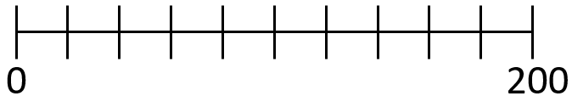
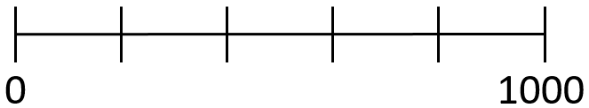
Reading Scales
What numbers are the arrows pointing to on these scales?

Slide 13
Reading Scales
What numbers are the arrows pointing to on these scales?
60
700

Slide 14
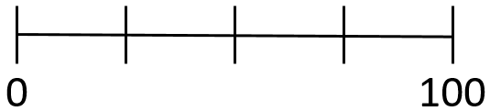
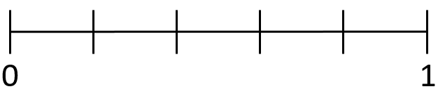
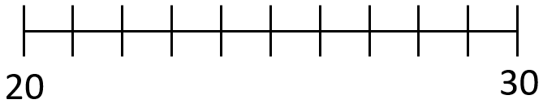
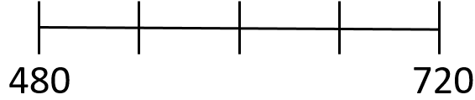
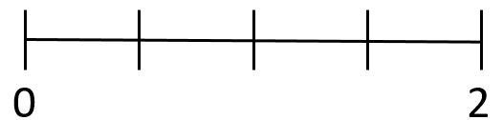
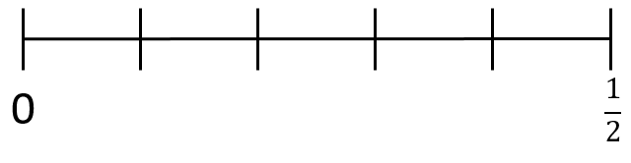
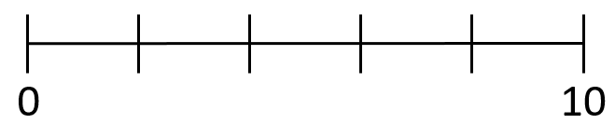
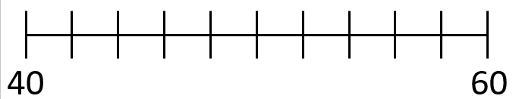
Exercise
What numbers are the arrows pointing to on these scales?.

Slide 15
Solutions
What numbers are the arrows pointing to on these scales?.
160
75
0.2
24
660
1.25
0.7
56
0.15

Slide 16
Decimals : Example
What is the value of the green digit in each number?
a)
0.59
b)
0.7493

Slide 17
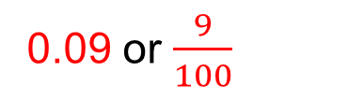
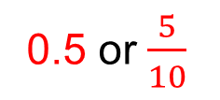
Solutions
What is the value of the green digit in each number?
a)
0.59
0.5 or $\frac{5}{10}$
b)
0.7493
0.09 or $\frac{9}{100}$
Tens | Units |  | Tenths | Hundredths | Thousandths | Ten thousandths
0 | 0 |  | 5 | 9 | 0 | 0
0 | 0 |  | 7 | 4 | 9 | 3

Slide 18
Exercise
Write down the value of each green digit:
a) 0.03
b) 12.754
c) 1.239
d) 0.6
e) 99.4021
f) 13.001
Challenge
How many numbers are there between 0.00001 and 0.00002?
0
g) 12.000 003

Slide 19
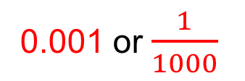
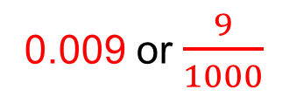
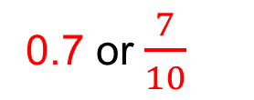
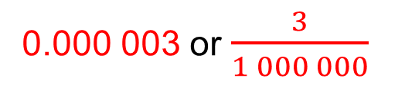
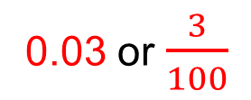
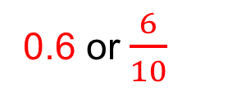
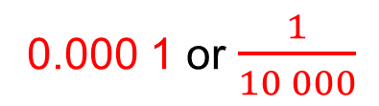
Solutions
Write down the value of each green digit:
0.03 or $\frac{3}{100}$
b) 12.754
0.7 or $\frac{7}{10}$
c) 1.239
0.009 or $\frac{9}{1000}$
a) 0.03
0.6 or $\frac{6}{10}$
0.000 1 or $\frac{1}{10 000}$
0.001 or $\frac{1}{1000}$
d) 0.6
e) 99.4021
f) 13.001
Challenge
How many numbers are there between 0.00001 and 0.00002?
0.000 003 or $\frac{3}{1 000 000}$
0
g) 12.000 003
An infinite number

Slide 20
Ordering Decimals : Example
Which of these numbers is largest?
0.59
0.7

Slide 21
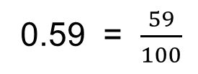
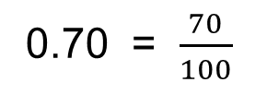
Solution
Which of these numbers is largest?
0.70 = $\frac{70}{100}$
0.59 = $\frac{59}{100}$
Therefore 0.7 > 0.59

Slide 22
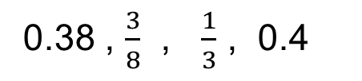

Exercise
Write these numbers in ascending order
Write these numbers in ascending order:
Which of these is largest?
$$0.\dot{9} , 1$$
1.
0.8 , 0.72 , 0.691 , 0.7
1.
4.381 , 4.49 , 4.5 , 4.38
2.
0.38 , $\frac{3}{8}$ , $\frac{1}{3}$ , 0.4
2.
0.01 , 0.10 , 0.039 , 0.3
3.
7.9 , 7.89 , 7.98 , 7.8

Slide 23
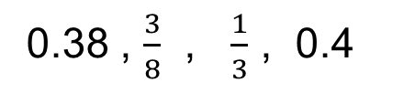
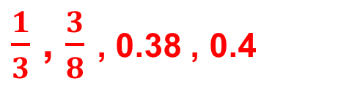

Solutions
Write these numbers in ascending order
Write these numbers in ascending order:
Which of these is largest?
$$0.\dot{9} , 1$$
1.
0.8 , 0.72 , 0.691 , 0.7
1.
4.381 , 4.49 , 4.5 , 4.38
0.691 , 0.7 , 0.72 , 0.8
4.38 , 4.381 , 4.49 , 4.5
They are the same!
2.
0.38 , $\frac{3}{8}$ , $\frac{1}{3}$ , 0.4
2.
0.01 , 0.10 , 0.039 , 0.3
0.01 , 0.039 , 0.10 , 0.3
$\frac{1}{3}$ , $\frac{3}{8}$ , 0.38 , 0.4
3.
7.9 , 7.89 , 7.98 , 7.8
7.8 , 7.89 , 7.9 , 7.98

Slide 24
Extension
In the binary number system, the number 2 is the base instead of 10.
In the binary system, we can write any number using just zeroes and ones.
1011 in binary is equal to 8 + 2 + 1 = 11
64 | 32 | 16 | 8 | 4 | 2 | 1
 |  |  | 1 | 0 | 1 | 1
Convert these numbers from binary to decimal.
a) 101
b) 1 111
c) 1 000 000
Convert these numbers from decimal to binary.
a) 18
b) 23
c) 100

Slide 25
Solution
In the binary number system, the number 2 is the base instead of 10.
In the binary system, we can write any number using just zeroes and ones.
1011 in binary is equal to 8 + 2 + 1 = 11
64 | 32 | 16 | 8 | 4 | 2 | 1
 |  |  | 1 | 0 | 1 | 1
Convert these numbers from binary to decimal.
a) 101
= 5
b) 1 111
= 15
c) 1 000 000
= 64
Convert these numbers from decimal to binary.
a) 18
= 10010
b) 23
= 10111
c) 100
= 4

Slide 26




Exam Style Question
Circle the value of the digit 6 in 0.067
$$\frac{1}{60}$$
$$\frac{1}{6}$$
$$\frac{6}{100}$$
$$\frac{6}{10}$$

Slide 27
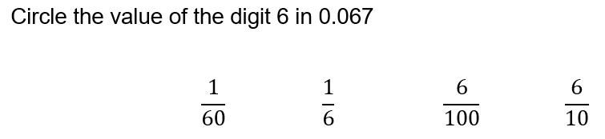
Solution

