Slide 1
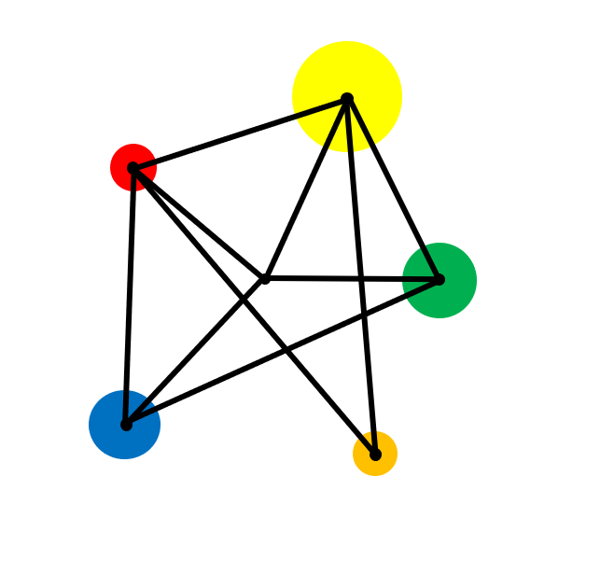
Co-ordinates

Slide 2
Vocabulary
Point
An exact position. Points are often named using a capital letter.
Axis
A straight line. The x axis is horizontal, and the y axis is vertical.
The plural of axis is axes.
Coordinates
A pair of numbers that give the location of a point such as (2 , 4).
Graph
A set of points drawn on axes, usually joined with a line or curve.
Quadrant
One of the four regions defined by the x axis and y axis.
Line Segment
A finite straight line with two ends.
Midpoint
The point at the middle of a line segment.

Slide 3

1. Use co ordinates to plot points in all four quadrants.
2. Find the midpoint of a line segment.
3. Plot graphs of simple equations.

Slide 4
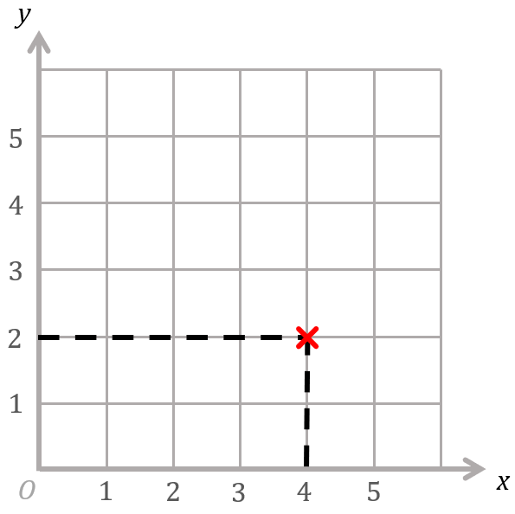
Key Facts
Any point can be described by a pair of numbers called co-ordinates.
The co-ordinates of the red cross are ( 4 , 2 ).
The first number is the x co-ordinate.
The second number is the y co-ordinate.
(x , y)

Slide 5
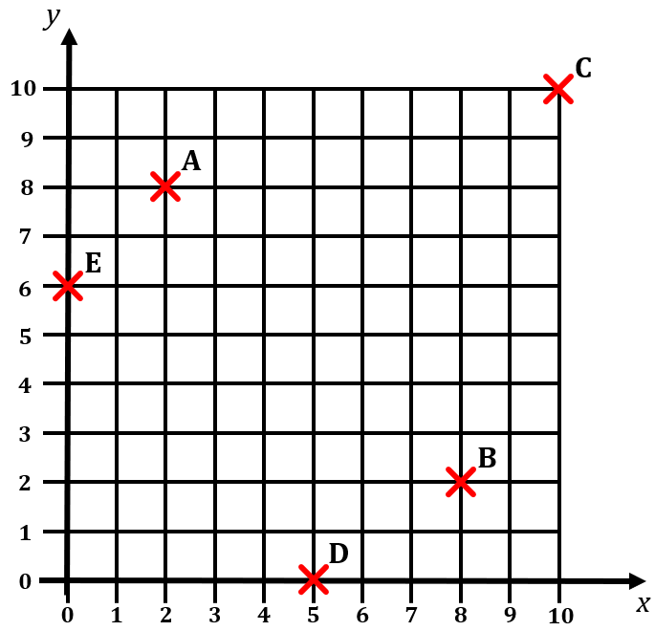
Example
What are the co-ordinates of the points A , B , C , D & E ?

Slide 6
Solutions
What are the co-ordinates of the points A , B , C , D & E ?
A (2 , 8)
B (8 , 2)
C (10 , 10)
D (5 , 0)
E (0 , 6)

Slide 7
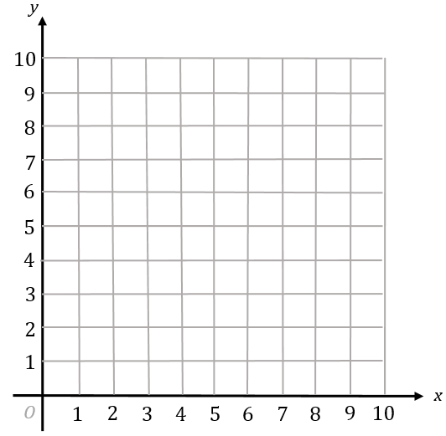
In each diagram, plot the points given by the co-ordinates and join the points with a ruler.
Write down the name of each of the quadrilaterals that you have drawn.
(2 , 2)
(8 , 2)
(8 , 8)
(2 , 8)
(2 , 3)
(8 , 3)
(8 , 7)
(2 , 7)
(5 , 2)
(8 , 6)
(5 , 8)
(2 ,6)
(2 , 2)
(7 , 2)
(9 , 6)
(4 , 6)
(2 , 2) (8 , 2) (6 , 6) (4 , 6)
(5 , 2)
(9 , 5)
(5 , 8)
(1 , 5)

Slide 8
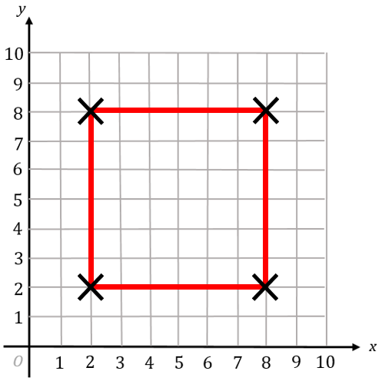
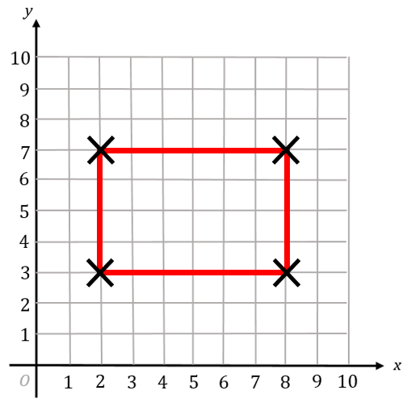
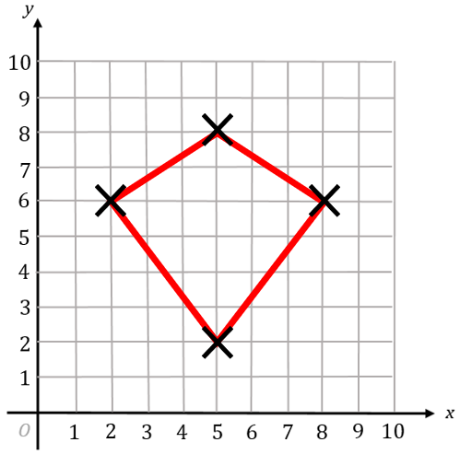
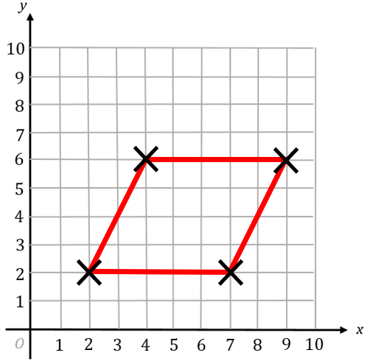
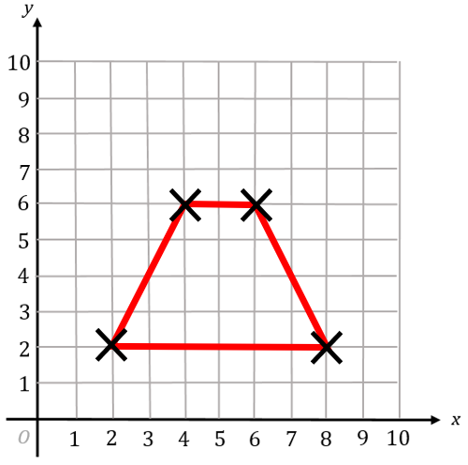
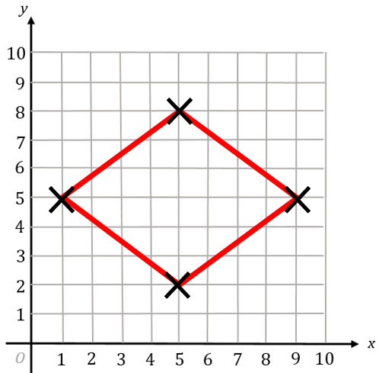
(2 , 2)
(8 , 2)
(8 , 8)
(2 , 8)
(2 , 3)
(8 , 3)
(8 , 7)
(2 , 7)
(5 , 2)
(8 , 6)
(5 , 8)
(2 , 6)
Square
Rectangle
Kite
(2 , 2) (7 , 2) (9 , 6) (4 , 6)
(2 , 2) (8 , 2) (6 , 6) (4 , 6)
(5 , 2) (9 , 5) (5 , 8) (1 , 5)
Parallelogram
Trapezium
Rhombus

Slide 9
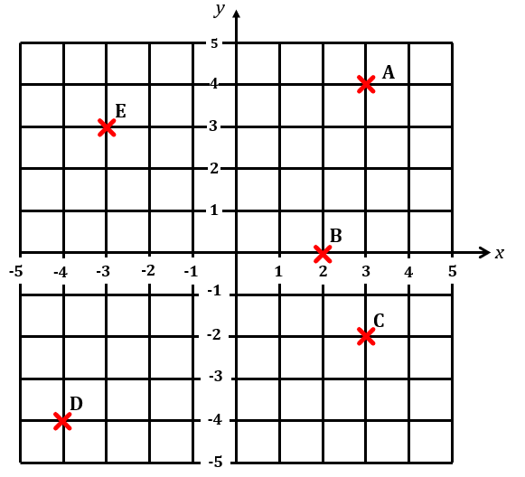
Question
We can extend co-ordinates to negative numbers.
What are the co-ordinates of the points A , B , C , D , E?

Slide 10
Solution
We can extend co-ordinates to negative numbers.
What are the co-ordinates of the points A , B , C , D , E?
A (4 , 4)
B (2 , 0)
C (3 , - 2)
D (- 4 , - 4)
E (- 3 , 3)

Slide 11
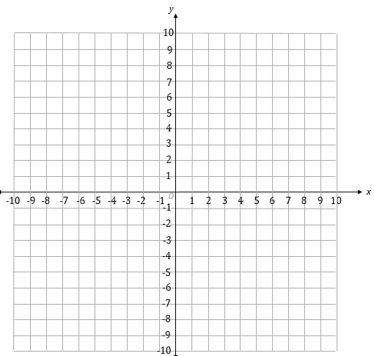
Key Fact
The x axis and y axis divide the co ordinate grid into four quadrants.
Quadrant 2
Quadrant 1
Quadrant 3
Quadrant 4

Slide 12
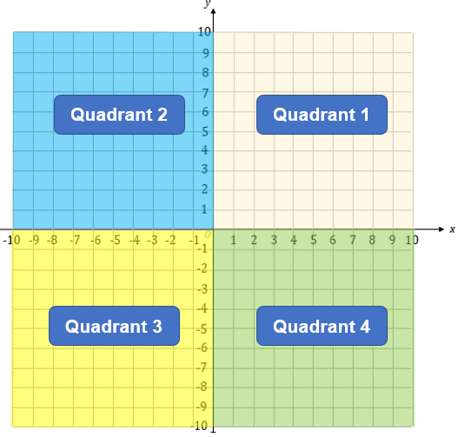
Question
In which quadrant do the following points lie?
a) ( - 1 , 5)
b) (3 , 3)
c) ( - 2 , - 4)
d) (4 , - 3)
e) (0 , 0)
f) ( - 7 , 0)

Slide 13
Solution
a) ( - 1 , 5)
2nd Quadrant
b) (3 , 3)
1st Quadrant
Quadrant 2
Quadrant 1
c) ( - 2 , - 4)
3rd Quadrant
d) (4 , - 3)
4th Quadrant
e) (0 , 0)
All 4 Quadrants
f) ( - 7 , 0)
Quadrants 2 & 3
Quadrant 3
Quadrant 4

Slide 14
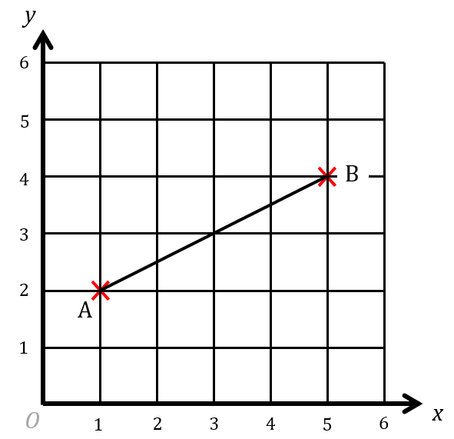
Question
Where is the midpoint of the line segment AB?

Slide 15
Solution
A (1 , 5)
B (3 , 3)
The midpoint is at (3 , 3).

Slide 16
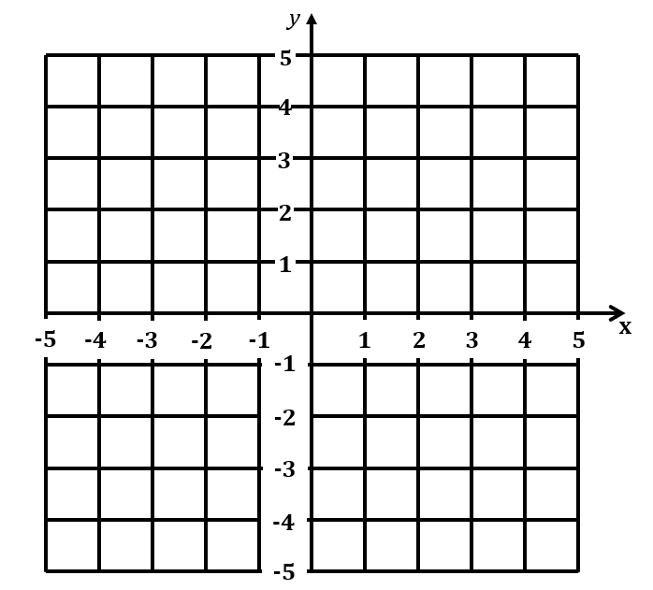
Exercise
Find the midpoint of each line segment.

Slide 17
Solutions
Find the midpoint of each line segment.
(3 , 3)
(1 , 2)
(-1 , 0)
(2 , 0)
(-0.5 , 0.5)
(-0.5 , 3)

Slide 18
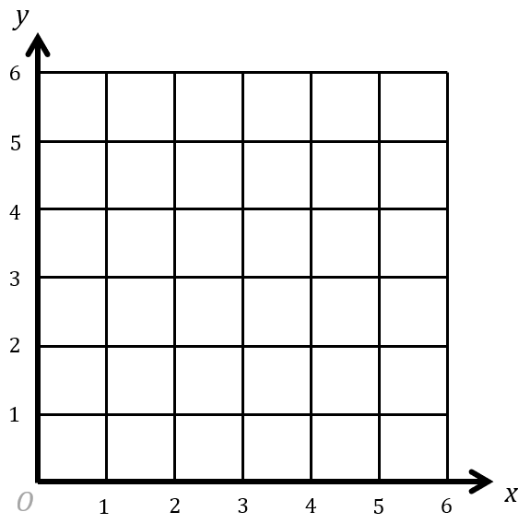

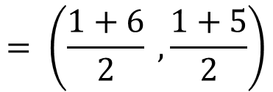
Key Fact
You can find the midpoint of a line segment as follows:
Midpoint of (1 , 1) and (6 , 5)
$$= \left(\frac{1+6}{2} , \frac{1+5}{2}\right)$$
$$= (3.5 , 3)$$

Slide 19
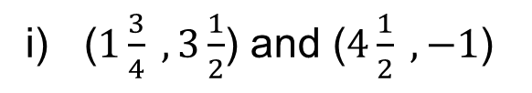
Exercise
Find the midpoint of the line segment joining each pair of points?
a) (1 , 1) and (5 , 5)
b) (2 , 6) and (8 , 12)
c) (0 , 0) and (3 , 6)
d) (1 , 1) and (5 , 5)
e) ( - 4 , 8) and (8 , 4)
f) ( - 1 , - 1) and (4 , 5)
g) ( - 4 , - 2) and ( - 2 , - 4)
h) (1.5 , - 3) and (4 , 0)
i) ($1\frac{3}{4} , 3\frac{1}{2}$) and ($4\frac{1}{2} , −1$)

Slide 20
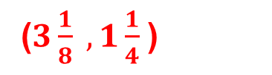
Solutions
Find the midpoint of the line segment joining each pair of points?
a) (1 , 1) and (5 , 5)
b) (2 , 6) and (8 , 12)
c) (0 , 0) and (3 , 6)
(3 , 3)
(5 , 9)
(1.5 , 3)
d) (1 , 1) and (5 , 5)
e) ( - 4 , 8) and (8 , 4)
f) ( - 1 , - 1) and (4 , 5)
(2 , 2)
(2 , 6)
(1.5 , 2)
g) ( - 4 , - 2) and ( - 2 , - 4)
h) (1.5 , - 3) and (4 , 0)
i) ($1\frac{3}{4} , 3\frac{1}{2}$) and ($4\frac{1}{2} , −1$)
(-3 , -3)
(2.75 , -1.5)
($3\frac{1}{8} , 1\frac{1}{4}$)

Slide 21
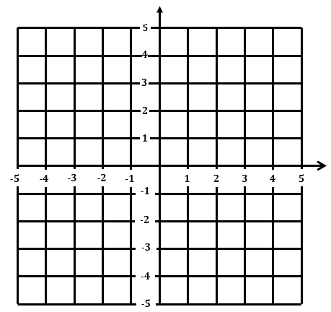
Straight Line Graphs
Plot these points on a co-ordinate grid.
(- 5 , 3)
(- 3 , 3)
(0 , 3)
(2 , 3)
(4 , 3)
What do you notice about the points that you have plotted?

Slide 22
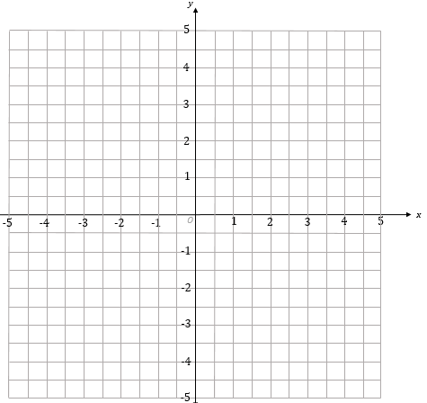

Slide 23
Straight Line Graphs
(- 5 , 3)
(- 3 , 3)
(0 , 3)
(2 , 3)
(4 , 3)
The points all lie on a straight line.
This graph is called y = 3.

Slide 24
Exercise
Draw the graphs of these equations.
y = 1
y = - 4
x = 5
x = 0
Challenge : Draw the graph of x + y = 4

Slide 26
Solutions
Draw the graphs of these equations.
y = 1
y = - 4
x = 5
x = 0
Challenge: Draw the graph of x + y = 4

Slide 27
Match the graphs with their equations
y = 5
x + y = 5
x = - 4
x = 2
y = 0

Slide 28
Solutions
x = 5
x = 0
x + y = 4
y = 1
y = - 4
x + y = 4 passes through (0 , 4) , (1 , 3) , (2 , 2) …

Slide 29
Other Straight Line Graphs
Plot these points on a co-ordinate grid.
(-5 , -5)
(-3 , -3)
(0 , 0)
(2 , 2)
(1 , 1)
(5 , 5)
What do you notice about the points that you have plotted?

Slide 31
Solutions
The points all lie on a straight line.
(-5 , -5)
(-3 , -3)
(0 , 0)
(2 , 2)
(4 , 4)
This line is the graph of y = x

Slide 32
Exercise
Draw the graphs of these equations on separate axes.
a)
y = x + 1
b)
y = x - 2
c)
y = - x
Challenge: Draw the graph of y = x²

Slide 33
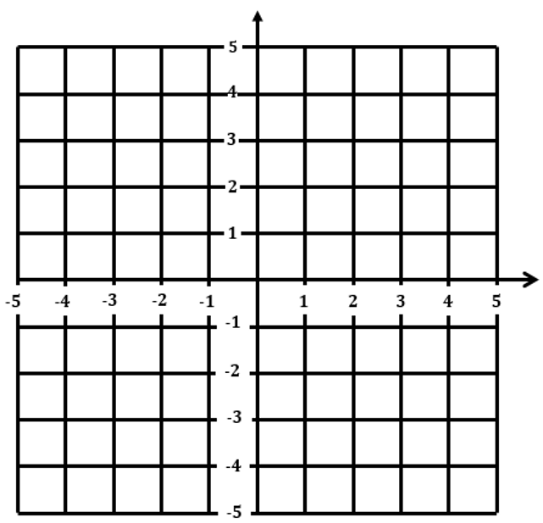
a)
b)
Solutions
y = x + 1
y = x - 2
c)
d)
y = - x
y = x²

Slide 34
Extension
Write down the equations of each side of the hexagon?
Write down the midpoints of each side?
y
x

Slide 35
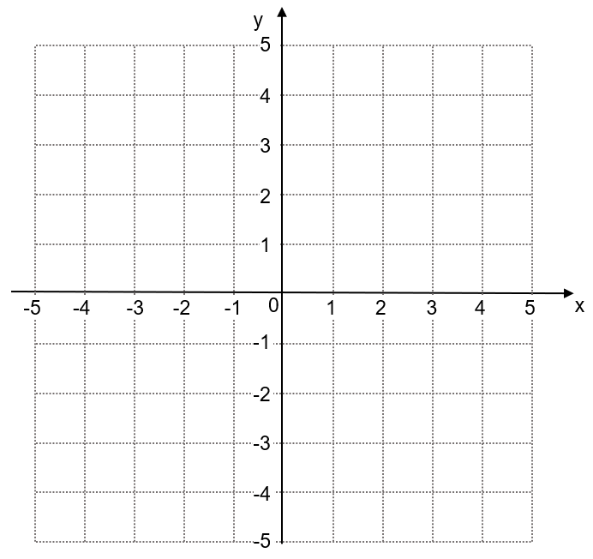
Exam Style Question
Point A is plotted at (3 , 4) on this centimetre square grid.
A.
Point A is the corner of a square with area 25cm².
The other corners of the square have integer coordinates and lie on the grid.
x
a) Find the coordinates of the corner of the square that is diagonally opposite point A.
b) Find the coordinates of the midpoint of the diagonal of the square.

Slide 36
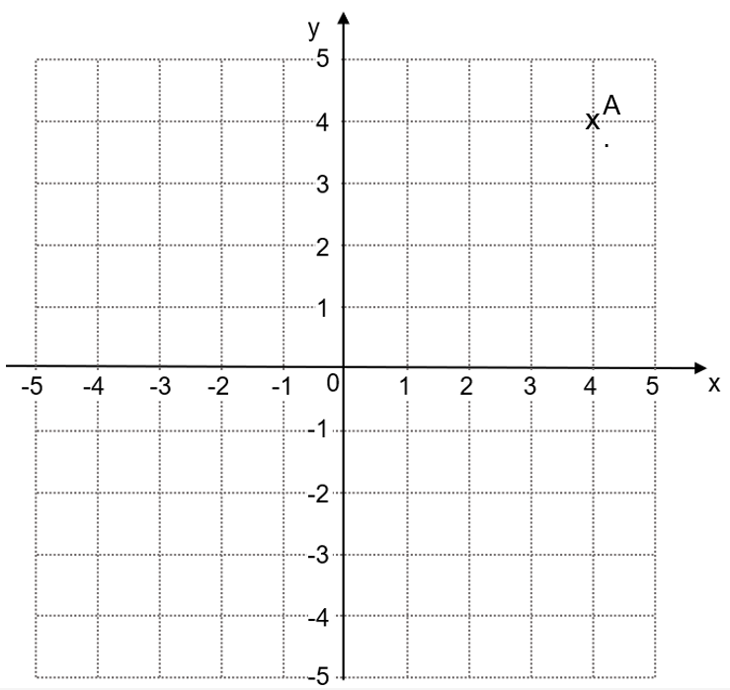
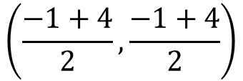
Solution
a) Find the coordinates of the corner of the square that is diagonally opposite point A.
A(-1 , -1)
b) Find the coordinates of the midpoint of the diagonal of the square.
Midpoint is at the point with co-ordinates:
$$\left(\frac{−1+4}{2},\frac{−1+4}{2}\right)$$
= (1.5 , 1.5)

Slide 37
Exam Style Question
A (0 , 3) and B (6 , 5) are points on the straight line ABCD
y
D
C
B (3 , 5)
A (0 , 3)
x
AB = BC = CD
Work out the coordinates of D

Slide 38
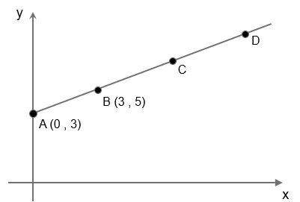
Solution
Work out the coordinates of D.
D = (3 + 3 + 3, 5 + 2 + 2))
D = (9, 9)

Slide 39
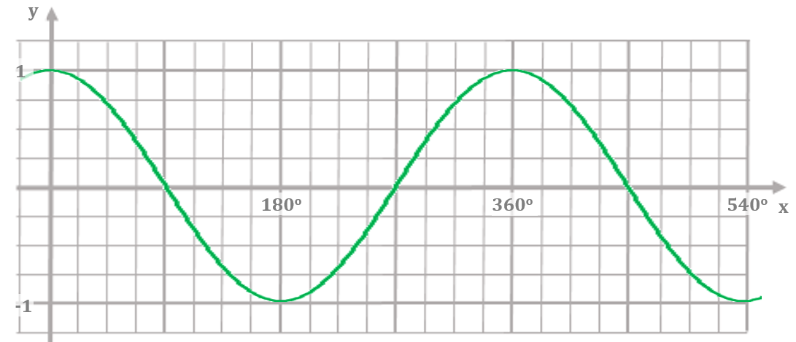
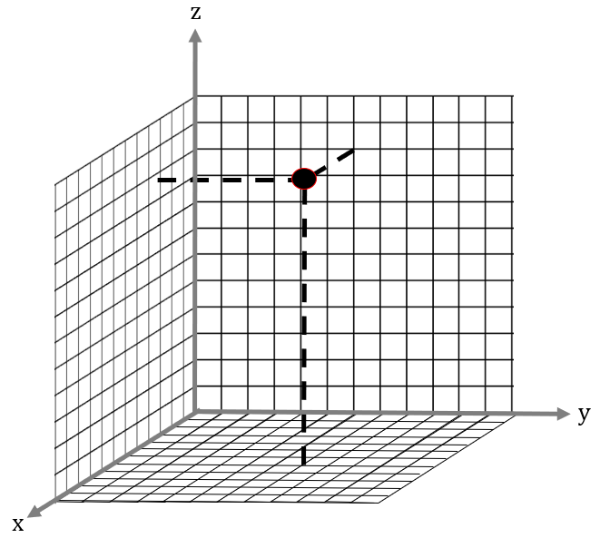
Where next?
More complex graphs
In your GCSE studies you will meet many types of graphs including quadratic, cubic, exponential and trigonometrical graphs
3D coordinates
The world we live in is three dimensional. In order to study properties of the real world, we learn how to deal with co ordinates in three dimensions. To help us study co ordinates in three dimensions, we need an x axis, a y axis and also a z axis.

Slide 40
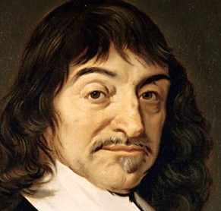
Historical links
The x-y plane is called the Cartesian plane in honour of René Descartes, a French mathematician who lived between 1596 and 1650.
Descartes was one of the first people to represent algebraic relationships using graphs that we recognize today. This paved the way for the invention of calculus – one of the most important discoveries ever made in mathematics.

