Slide 1
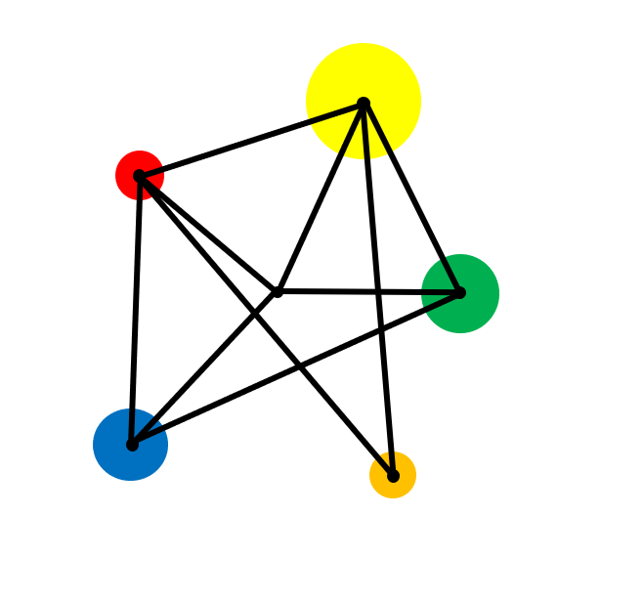
Decimal Arithmetic

Slide 2
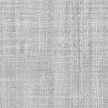
Add, Subtract, Multiply & Divide Decimals
Calculate with money

Slide 3
Vocabulary
Decimal
A system of numbers and arithmetic based on the number ten and powers of ten.
Decimal Point
A dot used to separate the whole number part from the fractional part of a number.
Evaluate
To calculate the value of something.
Arithmetic
The use of the four operations of addition, subtraction, multiplication and division.

Slide 4
Example: Addition of Decimals
Evaluate without a calculator :
9.6 + 18.7

Slide 5
Solution
9 . 6
Make sure the decimal points are lined up.
1 8 . 7
+
2 8 . 3
1
1
9.6 + 18.7 = 28.3

Slide 6
Exercise
Evaluate without a calculator:
Evaluate without a calculator:
Evaluate without a calculator:
a) 1.4 + 2.3
a) 3.07 + 0.38
a) 9.9 + 1.99
b) 4.4 + 5.6
b) 1.069 + 4.68
b) 0.89 + 0.098
c) 12.3 + 6.8
c) 1.3 + 3.14 + 4.607
c) 0.9 + 0.99 + 0.999
d) 12.3 + 6.8
d) 0.91 + 0.09
e) 8.6 + 0.51

Slide 7
Solutions
Evaluate without a calculator:
Evaluate without a calculator:
Evaluate without a calculator:
a) 1.4 + 2.3
a) 3.07 + 0.38
a) 9.9 + 1.99
= 11.89
= 3.7
= 3.45
b) 4.4 + 5.6
b) 1.069 + 4.68
= 5.749
b) 0.89 + 0.098
= 0.988
= 10
c) 12.3 + 6.8
c) 1.3 + 3.14 + 4.607
c) 0.9 + 0.99 + 0.999
= 19.1
= 9.047
= 2.889
d) 12.3 + 6.8
d) 0.91 + 0.09
= 1
= 10.7
e) 8.6 + 0.51
= 9.11

Slide 8
Examples: Subtraction of Decimals
Evaluate without a calculator:
6.4 - 2.66

Slide 9
Answer
1
Notice the zero here
5
3
1
6 . 4 0
-
2 . 6 6
3 . 7 4
6.4 - 2.66 = 3.74

Slide 10
Exercise
Evaluate without a calculator:
Evaluate without a calculator:
Evaluate without a calculator:
a) 3.4 - 1.2
a) 8.2 – 4.5
a) 4.1 – 1.11
b) 5.9 - 4.6
b) 2.1 – 1.9
b) 11 – 1.98
c) 9.68 - 2.64
c) 18.75 - 4.56
c) 9 – 0.9 – 0.99
d) 6.3 - 1.3
d) 14.3 - 1.68
d) 3.012 – 2.213
e) 4.4 - 0.6
e) 2.68 - 1.86

Slide 11
Solutions
Evaluate without a calculator:
Evaluate without a calculator:
Evaluate without a calculator:
a) 3.4 - 1.2
= 2.2
a) 8.2 – 4.5
= 3.7
a) 4.1 – 1.11
= 2.99
b) 5.9 - 4.6
= 1.3
b) 2.1 – 1.9
= 0.2
b) 11 – 1.98
= 9.02
c) 9.68 - 2.64
c) 18.75 - 4.56
c) 9 – 0.9 – 0.99
= 7.11
= 7.04
= 14.19
d) 6.3 - 1.3
= 5
d) 14.3 - 1.68
= 12.62
d) 3.012 – 2.213
= 0.799
e) 4.4 - 0.6
= 3.8
e) 2.68 - 1.86
= 0.82

Slide 12
Example : Multiplication of Decimals
Evaluate without a calculator:
1.2 x 0.6

Slide 13

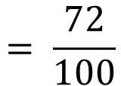
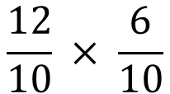
Example : Multiplication of Decimals
Method 1
1.2 x 0.6
Convert the decimals into fractions.
$$\frac{12}{10} × \frac{6}{10}$$
$$= \frac{72}{100}$$
Multiply the fractions.
Convert the fraction to a decimal.
$$= 0.72$$

Slide 14
Example : Multiplication of Decimals
Method 2
1.2 x 0.6
Remove the decimal points
12 x 6 = 72
Use an estimate to decide where the decimal point should go in the answer.
1.2 x 0.6 = 0.72

Slide 15

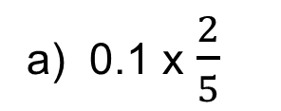
Exercise
Evaluate without a calculator:
Evaluate without a calculator:
Evaluate without a calculator:
a) 4 x 2.1
a) 0.1 x $\frac{2}{5}$
a) 0.4 x 0.4
b) 0.3 x 3
b) 0.3 x 0.3
b) ${\left(0.2\right)}^{5}$
c) 7.8 x 3
c) 0.323 x 0.21
d) 5 x 4.23
d) 0.99 x 0.89
e) 0.6 x 1.2

Slide 16
Solutions
Evaluate without a calculator:
Evaluate without a calculator:
Evaluate without a calculator:
a) 4 x 2.1
a) 0.1 x $\frac{2}{5}$
= 8.4
a) 0.4 x 0.4
= 0.16
= 0.04
b) 0.3 x 3
= 0.9
b) 0.3 x 0.3
= 0.09
b) ${\left(0.2\right)}^{5}$
= 0.00032
c) 7.8 x 3
= 23.4
c) 0.323 x 0.21
= 0.06783
d) 5 x 4.23
= 21.15
d) 0.99 x 0.89
= 0.8811
e) 0.6 x 1.2
= 0.72

Slide 17
Example : Division of Decimals
Evaluate without a calculator:
1340 ÷ 0.4

Slide 18

Solution
1340 ÷ 0.4
Remove the decimal points
134 ÷ 4 = 33.5
Use an estimate to decide where the decimal point should go in the answer.
134 ÷ 0.4 = 335

Slide 19
Exercise
Evaluate without a calculator:
Evaluate without a calculator:
Solve these equations:
1.
12 ÷ 8
1.
1 ÷ 0.1
1.
2x = 37
2.
1.2 ÷ 8
2.
40 ÷ 0.5
2.
5x = 0.2
3.
12 ÷ 80
3.
12 ÷ 0.12
3.
3x = 17
4.
12 ÷ 0.8
4.
7.08 ÷ 0.3
5.
120 ÷ 80
6.
1.2 ÷ 80

Slide 20
Exercise
Evaluate without a calculator:
Evaluate without a calculator:
Solve these equations:
= 1.5
= 10
1.
x = 17.5
1.
12 ÷ 8
1.
1 ÷ 0.1
2x = 37
= 0.15
= 80
2.
5x = 0.2
2.
1.2 ÷ 8
2.
40 ÷ 0.5
x = 0.04
.
= 0.15
x = 5.3
3.
12 ÷ 80
3.
12 ÷ 0.12
= 100
3.
3x = 17
12 ÷ 0.8
4.
= 23.6
4.
= 15
7.08 ÷ 0.3
= 1.5
5.
120 ÷ 80
= 0.015
6.
1.2 ÷ 80

Slide 21

Mixed Questions
Work out without a calculator
1.
8.6 + 6.81
2.
14.1 – 9.41
3.
4.6 x 8
4.
10 ÷ 20
5.
8 ÷ 40
6.
2.8 – 0.92
7.
5.26 + 8.84
8.
1.4 x 1.5
9.
1.11 + 1.99
10.
0.3 x 0.3
11.
0.2 ÷ 0.01
12.
4.1 – 4.01
13.
11.51 – 5.6
14.
33 ÷ 1.1
15.
(2.1)²
16.
$$\frac{1.2}{0.2}$$
17.
1680 ÷ 200
18.
0.09 ÷ 4
19.
24.2 x 0.8
20.
4.01 – 4.1

Slide 22
Solutions
Work out without a calculator
1.
8.6 + 6.81
= 15.41
2.
14.1 – 9.41
= 4.7
3.
4.6 x 8
= 36.8
4.
10 ÷ 20
= 0.5
5.
8 ÷ 40
= 0.2
6.
2.8 – 0.92
= 1.88
7.
5.26 + 8.84
8.
1.4 x 1.5
= 2.1
= 14.1
9.
1.11 + 1.99
= 3.1
10.
0.3 x 0.3
= 0.09
11.
0.2 ÷ 0.01
= 20
12.
4.1 – 4.01
= 0.09
13.
11.51 – 5.6
= 5.91
$$\frac{1.2}{0.2}$$
14.
33 ÷ 1.1
= 30
15.
(2.1)²
= 4.41
16.
= 6
17.
1680 ÷ 200
18.
0.09 ÷ 4
19.
24.2 x 0.8
20.
4.01 – 4.1
= 8.4
= 0.0225
= 19.36
= - 0.09

Slide 23
Example: Multiplying and dividing by 10
Evaluate without a calculator:
a) 8 x 10
c) 12.4 x 10
b) 220 ÷ 10
d) 0. 31 ÷ 10

Slide 24
Solutions
Evaluate without a calculator:
a) 8 x 10 = 80
c) 12.4 x 10 = 124
b) 220 ÷ 10 = 22
d) 0. 31 ÷ 10 = 0.031

Slide 25
Exercise
Evaluate without a calculator:
Evaluate without a calculator:
Evaluate without a calculator:
a) 5 x 10
a) 51 x 10
a) 4.5 x 10 x 10
b) 17 x 10
b) 51 ÷ 10
b) 1.7 x 10 ÷ 10
c) 920 x 10
c) 0.51 x 10
c) 3 x 10²
d) 20 ÷ 10
d) 0.02 x 10
d) 2 x 10³
e) 1930 ÷ 10
e) 0.002 ÷ 10
f) 32 ÷ 10
f) 1 ÷ 10

Slide 26
Solutions
Evaluate without a calculator:
Evaluate without a calculator:
Evaluate without a calculator:
a) 5 x 10
= 50
a) 51 x 10
= 510
a) 4.5 x 10 x 10
= 450
b) 17 x 10
= 170
b) 51 ÷ 10
= 5.1
b) 1.7 x 10 ÷ 10
= 1.7
c) 920 x 10
= 9200
c) 0.51 x 10
= 5.1
c) 3 x 10²
= 300
d) 20 ÷ 10
= 2
d) 0.02 x 10
= 0.2
d) 2 x 10³
= 2000
e) 1930 ÷ 10
= 193
e) 0.002 ÷ 10
= 0.0002
f) 32 ÷ 10
= 3.2
f) 1 ÷ 10
= 0.1

Slide 27
Extension
In each sequence each term is multiplied by a certain number to get the next term.
Continue the following sequences:
a) 2 , 4 , 8 , 16 , ___ , ___
b) 2000 , 1000 , ___ , ___ , ___
c) 1000 , ___ , 640 , ___ , ___

Slide 28
Solutions
In each sequence each term is multiplied by a certain number to get the next term.
Continue the following sequences:
a) 2 , 4 , 8 , 16 , 32 , 64
b) 2000 , 1000 , 500 , 250 , 125
c) 1000 , 800 , 640 , 512 , 409.6

Slide 29
Exam Style Question
Here are some numbers.
8.4 11.4 14.2 6.4 11.2 16.2
Write the numbers in pairs so that the sum of the numbers in each pair is the same.

Slide 30
Solution
Here are some numbers.
8.4 11.4 14.2 6.4 11.2 16.2
Write the numbers in pairs so that the sum of the numbers in each pair is the same.
8.4 and 14.2
11.4 and 11.2
6.4 and 16.2

Slide 31
Solution
Here are some numbers.
8.4 11.4 14.2 6.4 11.2 16.2
Write the numbers in pairs so that the sum of the numbers in each pair is the same.

Slide 32
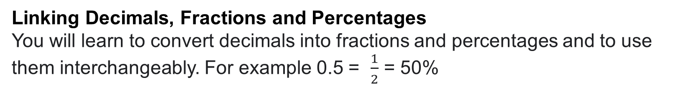
Where next?
Linking Decimals, Fractions and Percentages
You will learn to convert decimals into fractions and percentages and to use them interchangeably. For example 0.5 = $\frac{1}{2}$ = 50%
Money
You use decimals every time you calculate with money. For example, if you buy 5 pens for £1.99 each, the total cost will be 5 x £1.99.
Other calculations
Volume, area etc.

Slide 33
Historical links
The majority of number systems use ten as a base for representing numbers. This is believed to be because human beings have ten fingers and people began to count objects using their fingers.
However, there is no reason why ten is better than any other number. You may have heard of Binary, Octal and even Hexadecimal number systems The Hexadecimal system has 16 digits.
Nearly all number systems around the world use base 10 but this was not always the case. Until 1971, the UK did not use base ten for it’s money or it’s measurements. The United States of America does not use a decimal system for it’s measurement although it does for its currency.

