Slide 1
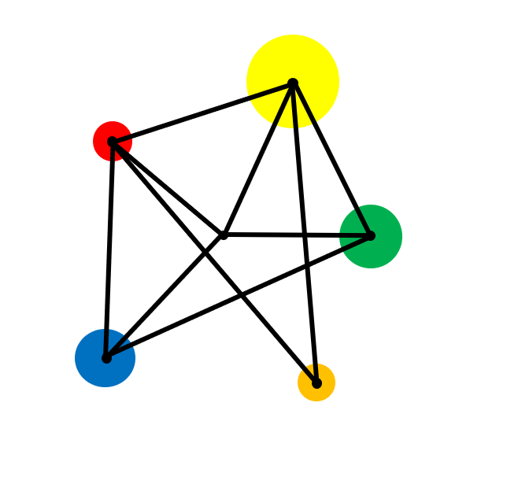
Powers

Slide 2
Calculate squares and square roots
Evaluate cubes and cube roots
Calculate positive powers of numbers

Slide 3
Vocabulary
Superscript
A number written above and to the right of another letter or number. For example, in 2³ the ‘3’ is the superscript.
Power
The power of a number tells us how many times to use the number in a multiplication.
It is written as a small number to the right and above the base number.
Index
A synonym for power. The plural of index is indices.

Slide 4
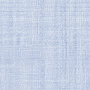
Key Facts
To ‘square’ a number, multiply it by itself.
‘3 squared’
= 3²
= 3 x 3
= 9

Slide 5
Examples
Evaluate:
a) 5²
b) 30²
c) 1.4²

Slide 6
Solutions
Evaluate:
a) 5²
b) 30²
c) 1.4²
= 5 x 5
= 30 x 30
= 1.2 x 1.2
= 25
= 900
= 1.44

Slide 7
Exercise
Evaluate without a calculator:
a)
1²
g)
7²
m)
13²
s)
19²
b)
2²
h)
8²
n)
14²
t)
20²
c)
3²
i)
9²
o)
15²
d)
4²
j)
10²
p)
16²
e)
5²
k)
11²
q)
17²
f)
6²
l)
12²
r)
18²

Slide 8
Solutions
Evaluate without a calculator:
a)
1²
= 1
g)
7²
= 49
m)
13²
= 169
s)
19²
= 361
b)
2²
= 4
h)
8²
= 64
n)
14²
= 196
t)
20²
= 400
c)
3²
= 9
i)
9²
= 81
o)
15²
= 225
d)
4²
= 16
j)
10²
= 100
p)
16²
= 256
e)
5²
= 25
k)
11²
= 121
q)
17²
= 289
f)
6²
= 36
l)
12²
= 144
r)
18²
= 324

Slide 9
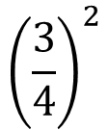

Exercise
Evaluate:
Evaluate:
Evaluate:
1)
5²
1)
90²
1)
$${\left(\frac{3}{4}\right)}^{2}$$
2)
8²
2)
0.8²
2)
$${\left(−3\right)}^{2}$$
3)
10²
3)
0.3²
4)
1²
4)
1.7²
5)
50²
5)
1 000²
6)
15²

Slide 10
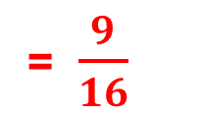
Solutions
Evaluate:
Evaluate:
Evaluate:
1)
5²
1)
90²
= 8100
1)
$${\left(\frac{3}{4}\right)}^{2}$$
= $\frac{9}{16}$
= 25
2)
8²
= 64
2)
0.8²
= 0.64
2)
$${\left(−3\right)}^{2}$$
= 9
3)
10²
= 100
3)
0.3²
= 0.09
4)
1²
= 1
4)
1.7²
= 2.89
5)
50²
= 2500
5)
1 000²
= 1 000 000
6)
15²
= 225

Slide 11
Key Facts
To ‘cube’ a number, multiply it by itself and then multiply by itself again.
2 cubed
= 2³
= 2 x 2 x 2

Slide 12
Examples
Evaluate:
a) 5³
b) 10³

Slide 13
Solutions
Evaluate:
a) 5³
b) 10³
= 5 x 5 x 5
= 10 x 10 x 10
= 125
= 1000

Slide 14
Exercise
Evaluate without a calculator:
1³
6³
Challenge
1³ + 2³ + 3³ + 4³ + 5³
= ?
2³
7³
3³
8³
4³
9³
5³
10³

Slide 15
Solutions
Evaluate without a calculator:
1³
= 1
6³
= 216
Challenge
1³ + 2³ + 3³ + 4³ + 5³
= 225
2³
= 8
7³
= 343
3³
= 27
8³
= 512
4³
= 64
9³
= 729
5³
= 125
10³
= 1000

Slide 16
Key Facts
Powers give a shorter way of describing repeated multiplications.
2¹ = 2
2² = 2 x 2 = 4
2³ = 2 x 2 x 2 = 8
2⁴ = ?

Slide 17
Example
Write
2 x 2 x 2 x 2 x 2 x 2 x 2 x 2 x 2 x 2 x 2 x 2 x 2 x 2 x 2 x 2 x 2 x 2 x 2 x 2
as a power.

Slide 18
Solution
2 x 2 x 2 x 2 x 2 x 2 x 2 x 2 x 2 x 2 x 2 x 2 x 2 x 2 x 2 x 2 x 2 x 2 x 2 x 2
= 2²⁰
(equal to 1,048,576)

Slide 19
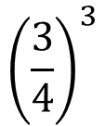
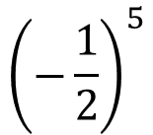

Exercise
Evaluate:
Evaluate:
Evaluate:
1)
7²
1)
15²
1)
$${\left(\frac{3}{4}\right)}^{3}$$
2)
3³
2)
9³
1⁵
3)
2¹⁰
2)
$${(−1)}^{100}$$
3)
4)
2⁴
4)
1²⁰
$${\left(−\frac{1}{2}\right)}^{5}$$
3)
5)
4²
5)
(- 2)²
6)
10³

Slide 20
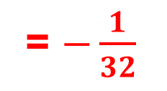
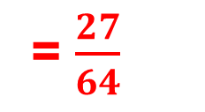
Solutions
Evaluate:
Evaluate:
Evaluate:
1)
7²
= 49
1)
15²
= 225
1)
$${\left(\frac{3}{4}\right)}^{3}$$
= $\frac{27}{64}$
2)
3³
= 27
2)
9³
= 729
1⁵
3)
2¹⁰
2)
$${(−1)}^{100}$$
= 1
3)
= 1
= 1024
4)
2⁴
= 16
4)
1²⁰
= 1
$${\left(−\frac{1}{2}\right)}^{5}$$
= $−\frac{1}{32}$
3)
5)
4²
= 16
5)
(- 2)²
= 4
6)
10³
= 1000

Slide 21
Exercise
Write as a power:
a)
3 x 3 x 3
b)
2 x 2 x 2 x 2
c)
10 x 10
d)
1 x 1 x 1 x 1 x 1 x 1
e)
e x e x e
f)
t x t x t x t
g)
2 x 2 x 2 x 5 x 5 x 5
h)
4 x 4 x 3 x 4 x 3
i)
5 x 5 x 5 x 5 ÷ 5
i)
(p x p x p) x ( p x p x p)
j)
(2 x 2 x 2)²
l)
3 x 3² x 3³

Slide 22
Solutions
Write as a power:
a)
3 x 3 x 3
b)
2 x 2 x 2 x 2
c)
10 x 10
= 3³
= 2⁴
= 10²
d)
1 x 1 x 1 x 1 x 1 x 1
e)
e x e x e
f)
t x t x t x t
= 1⁶
= e³
= t⁴
g)
2 x 2 x 2 x 5 x 5 x 5
h)
4 x 4 x 3 x 4 x 3
i)
5 x 5 x 5 x 5 ÷ 5
= 2³ x 5²
= 3² x 4³
= 5³
i)
(p x p x p) x ( p x p x p)
j)
(2 x 2 x 2)²
l)
3 x 3² x 3³
= p⁶
= 2⁶
= 3⁶

Slide 23
Exercise
Write these numbers as a power of a smaller number.
a)
25
b)
4
c)
100
d)
81
e)
8
f)
121
g)
27
h)
125
i)
225
j)
16
k)
625
l)
32

Slide 24
Solutions
Write these numbers as a power of a smaller number.
a)
25
b)
4
c)
100
= 10²
= 5²
= 2²
d)
81
= 9² or 3⁴
e)
8
f)
121
= 11²
= 2³
g)
27
= 3³
h)
125
= 5³
i)
225
= 15²
j)
16
= 4² or 2⁴
k)
625
= 25² or 5⁴
l)
32
= 2⁵

Slide 25




Key Fact: Square Roots
The inverse operation of ‘squaring’ is the square root operation.
$$5^{2} = 25$$
$$\sqrt{25} = 5$$
$$9^{2} = 81$$
$$\sqrt{81} = 9$$

Slide 26












Exercise
Evaluate:
a)
$$\sqrt{9}$$
b)
$$\sqrt{25}$$
c)
$$\sqrt{64}$$
d)
$$\sqrt{1}$$
e)
$$\sqrt{16}$$
f)
$$\sqrt{100}$$
g)
$$\sqrt{144}$$
h)
$$\sqrt{49}$$
i)
$$\sqrt{0}$$
j)
$$\sqrt{900}$$
k)
$$\sqrt{225}$$
l)
$$\sqrt{1 000 000}$$

Slide 27
Solutions
Evaluate:
a)
$$\sqrt{9}$$
= 3
b)
$$\sqrt{25}$$
= 5
c)
$$\sqrt{64}$$
= 8
d)
$$\sqrt{1}$$
= 1
e)
$$\sqrt{16}$$
= 4
f)
$$\sqrt{100}$$
= 10
g)
$$\sqrt{144}$$
= 12
h)
$$\sqrt{49}$$
= 7
i)
$$\sqrt{0}$$
= 0
j)
$$\sqrt{900}$$
= 30
k)
$$\sqrt{225}$$
= 15
l)
$$\sqrt{1 000 000}$$
= 1000

Slide 28




Key Fact: Cube Roots
The inverse operation of ‘cubing’ is the cube root operation.
$$3^{3} = 27$$
$$\sqrt[3]{27} = 3$$
$$9^{3} = 729$$
$$\sqrt[3]{729} = 9$$

Slide 29
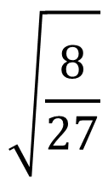











Exercise
Evaluate:
a)
$$\sqrt[3]{8}$$
b)
$$\sqrt[3]{1}$$
c)
$$\sqrt[3]{27}$$
d)
$$\sqrt[3]{1000}$$
e)
$$\sqrt[3]{0}$$
f)
$$\sqrt[3]{64}$$
g)
$$\sqrt[3]{125}$$
h)
$$\sqrt[3]{729}$$
i)
$$\sqrt[3]{−8}$$
$$\sqrt{\frac{8}{27}}$$
j)
$$\sqrt[3]{1331}$$
k)
$$\sqrt[3]{−64}$$
l)
3

Slide 30
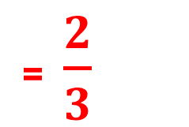
Solutions
Evaluate:
a)
$$\sqrt[3]{8}$$
= 2
b)
$$\sqrt[3]{1}$$
= 1
c)
$$\sqrt[3]{27}$$
= 3
d)
$$\sqrt[3]{1000}$$
= 10
e)
$$\sqrt[3]{0}$$
= 0
f)
$$\sqrt[3]{64}$$
= 4
g)
$$\sqrt[3]{125}$$
= 5
h)
$$\sqrt[3]{729}$$
= 9
i)
$$\sqrt[3]{−8}$$
= - 2
$$\sqrt{\frac{8}{27}}$$
= $\frac{2}{3}$
j)
$$\sqrt[3]{1331}$$
= 11
k)
$$\sqrt[3]{−64}$$
= - 4
l)
3

Slide 31

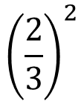


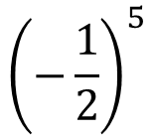


Mixed Exercise
Evaluate:
Evaluate:
Evaluate:
1)
6³
1)
3⁶
$${\left(\frac{2}{3}\right)}^{2}$$
1.)
2)
3⁶
2)
21²
20²
2)
$${(−3)}^{2}$$
3)
3.)
$$\sqrt{576}$$
4)
15²
4)
$$\sqrt[4]{16}$$
$${\left(−\frac{1}{2}\right)}^{5}$$
3)
5)
$$\sqrt{25}$$
5)
0.1³
6.
$$\sqrt[3]{8}$$

Slide 32
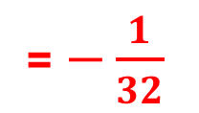
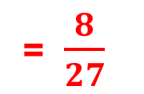
Solutions
Evaluate:
Evaluate:
Evaluate:
1)
6³
= 216
1)
3⁶
= 729
$${\left(\frac{2}{3}\right)}^{2}$$
= $\frac{8}{27}$
1.)
2)
3⁶
= 729
2)
21²
= 441
20²
2)
$${(−3)}^{2}$$
= 9
3)
= 400
3.)
$$\sqrt{576}$$
= 24
4)
15²
= 225
4)
$$\sqrt[4]{16}$$
= 2
$${\left(−\frac{1}{2}\right)}^{5}$$
= $−\frac{1}{32}$
3)
5)
$$\sqrt{25}$$
= 5
5)
0.1³
= 0.001
6.
$$\sqrt[3]{8}$$
= 2

Slide 33








Summary
To square a number, multiply it by itself.
Evaluate $8^{2}$
a³ means a x a x a .
Work out $5^{3}$
n times
y^{n} means y x y x y……….x y x y .
Calculate $3^{6}$
$\sqrt{x}$ means find the number whose square is x
Find $\sqrt{289}$
$\sqrt[3]{a }$ means find the number whose cube is a
Evaluate $\sqrt[3]{216}$

Slide 34


Solutions
Evaluate $8^{2}$
To square a number, multiply it by itself.
= 64
Work out $5^{3}$
a³ means a x a x a .
= 125
n times
y^{n} means y x y x y……….x y x y .
Calculate $3^{6}$
= 729
Find $\sqrt{289}$
$\sqrt{x}$ means find the number whose square is x
= 17
Evaluate $\sqrt[3]{216}$
$\sqrt[3]{a }$ means find the number whose cube is a
= 6

Slide 35
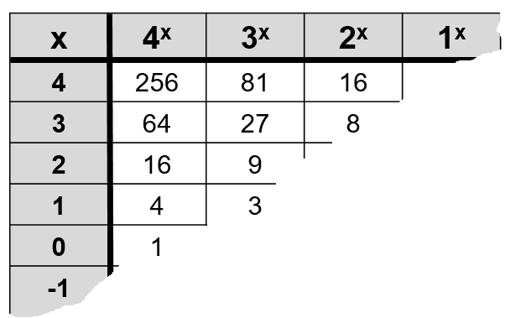
Extension
A table has been torn in half diagonally.
Can you reconstruct the table?

Slide 36
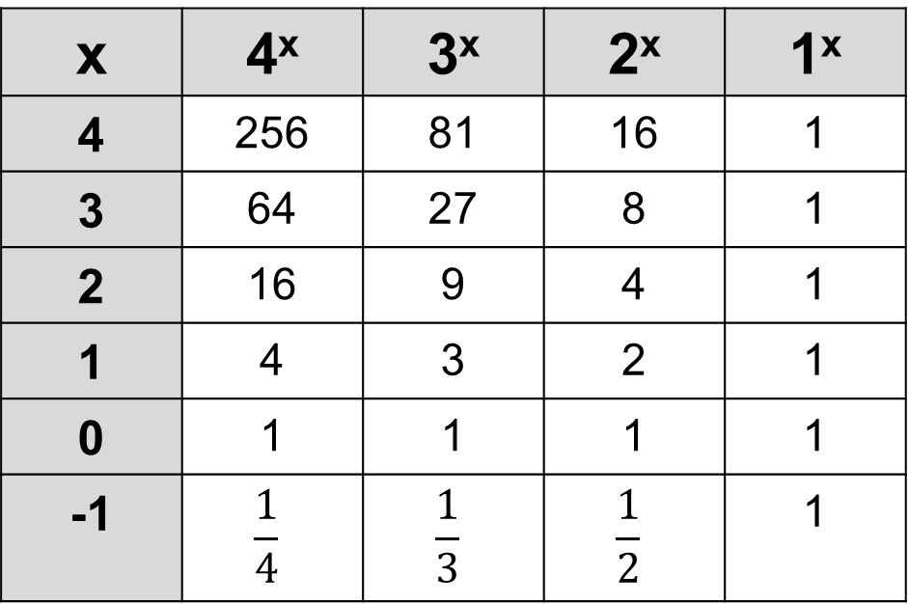
Solution
x | 4^{x} | 3^{x} | 2^{x} | 1^{x}
4 | 256 | 81 | 16 | 1
3 | 64 | 27 | 8 | 1
2 | 16 | 9 | 4 | 1
1 | 4 | 3 | 2 | 1
0 | 1 | 1 | 1 | 1
-1 | $$\frac{1}{4}$$ | $$\frac{1}{3}$$ | $$\frac{1}{2}$$ | 1

Slide 37
Exam Style Question
Show that 360 can be written as the sum of a cube number and a square number.
b) Find a value of x such that 2^{x} + 3^{x} = 35

Slide 38
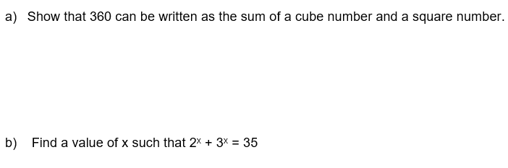
Solution
360 = 6³ + 12²
2³ + 3³ = 35
So x = 3

