Slide 1
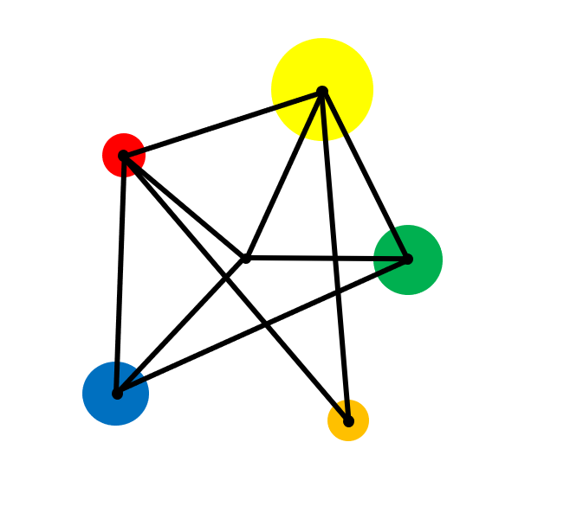
Probability

Slide 2
Understand the probability scale from 0 to 1
Write probabilities using fractions and decimals

Slide 3
Vocabulary
Probability
The chance that something will happen. A probability is always denoted by a number between 0 and 1.
Event
An outcome of an experiment.
Trial
A single run of an experiment.

Slide 4

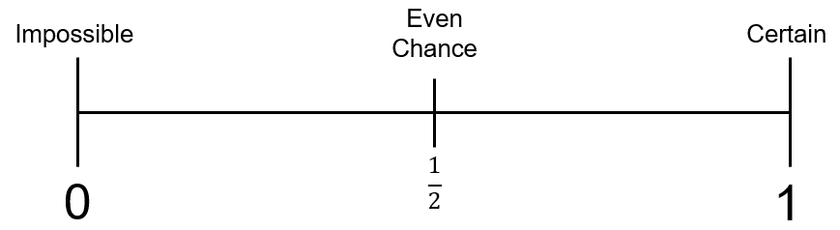
Key Facts
Probability is measured using a scale from 0 to 1
The probability of getting a head when we flip a fair coin is written as P(Head) = $\frac{1}{2}.$

Slide 5
Example
There are 10 round discs in a box.
5 discs are blue 1 disc is red 4 discs are yellow
One disc is selected at random from the box.
Mark on the diagram the probability that the disc is;
a) Blue b) Red c) Yellow d) Green e) Round

Slide 6
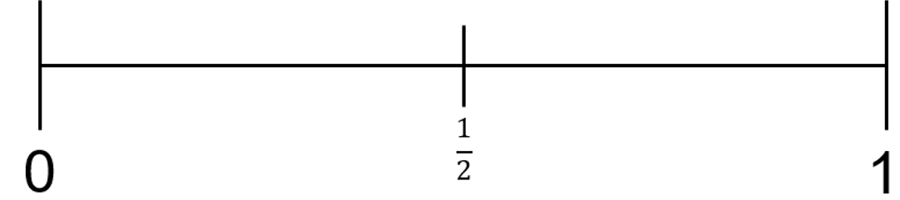
Solution
5 discs are blue 1 disc is red 4 discs are yellow
Green
Round
Blue
Red
Yellow
P(Blue) = $\frac{1}{2}$. P(Red) = $\frac{1}{10}$ P(Yellow) = $\frac{4}{10}$ P(Green) = 0 P(Round) = 1

Slide 7
Example
Nathaniel has some cards with the letters of his name on.
N
A
T
H
A
N
I
E
L
He picks one card at random.
Write down:
a)
P(H)
b)
P(A)
c) P(M)
d) P(Vowel)

Slide 8


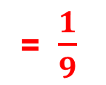
Example
Nathaniel has some cards with the letters of his name on.
N
A
T
H
A
N
I
E
L
He picks one card at random.
Write down:
= $\frac{1}{9}$
= $\frac{2}{9}$
= $\frac{4}{9}$
a)
P(H)
P(A)
= 0
d) P(Vowel)
b)
c) P(M)

Slide 9
Exercise
A fair coin is tossed once.
Write down:
When a fair dice is thrown, what is:
The numbers 4 to 104 are placed in a box. A number is taken at random.
Write down:
1.
P (Heads)
1.
P (6)
2.
P (Tails)
2.
P (1 or 2)
1.
P (100)
3.
P (Even)
3.
P (Not Tails)
2.
P (even number)
4.
P (Not 5)
4.
P (Heads or Tails)
3.
P (square number)
5.
P (7)
4.
P (prime number)
5.
P (Not Heads and Not Tails)
6.
P (Prime)

Slide 10













Solutions
A fair coin is tossed once.
Write down:
When a fair dice is thrown, what is:
The numbers 4 to 104 are placed in a box. A number is taken at random.
Write down:
1.
$$= \frac{1}{2}$$
$$= \frac{1}{6}$$
P (Heads)
1.
P (6)
2.
$$= \frac{2}{6}$$
2.
P (Tails)
$$= \frac{1}{2}$$
P (1 or 2)
$$= \frac{1}{101}$$
1.
P (100)
3.
P (Even)
$$= \frac{3}{6}$$
$$=\frac{1}{2}$$
$$= \frac{51}{101}$$
3.
P (Not Tails)
2.
P (even number)
4.
P (Not 5)
$$= \frac{5}{6}$$
3.
$$= \frac{9}{101}$$
4.
P (Heads or Tails)
$$= 1$$
P (square number)
5.
P (7)
= 0
4.
P (prime number)
$$= \frac{25}{101}$$
5.
P (Not Heads and Not Tails)
$$= \frac{3}{6}$$
6.
P (Prime)
= 0

Slide 11
Example
The probability that a train is late is $\frac{2}{3}$ .
What is the probability that the train is not late?
On how many days would you expect the train to be late in a month of 30 days?

Slide 12


Solution
The probability that a train is late is $\frac{2}{3}$.
$$\frac{1}{3}$$
What is the probability that the train is not late?
On how many days would you expect the train to be late in a month of 30 days?
$$\frac{2}{3}×30=20$$

Slide 13

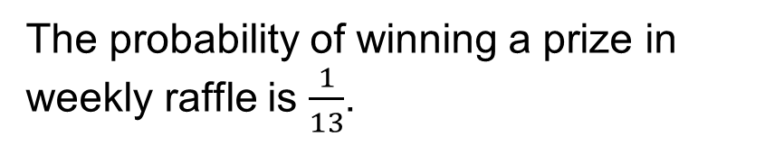
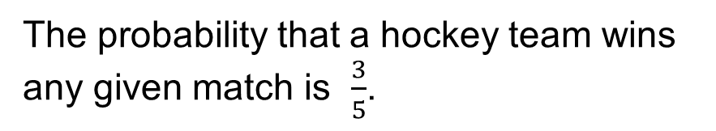
1)
A biased coin has P(Heads) = 0.6.
4)
The probability of winning a prize in weekly raffle is $\frac{1}{13}$.
a) What is P(tails) ?
b)
The coin is tossed 300 times
How many heads would you expect?
a)
What is the probability of not winning a prize?
b)
If you entered the raffle every week for a year, how many prizes would you expect to win?
2)
The probability that a hockey team wins any given match is $\frac{3}{5}$.
a)
What is the probability that the team does not win its next match?
5)
The probability of a website being down at any given moment is 0.0006.
b)
A season consists of 30 matches.
How many matches would you expect the team to win in a season?
a)
What the probability that the website is working correctly when I next visit?
3)
When a fair dice is thrown, P(6) = $\frac{1}{6}$.
b)
For how long would you expect the website to be down in a year of 365 days?
a)
What is P (Not 6) ?
b)
The dice is thrown 900 times
How many sixes would you expect?

Slide 14



1)
A biased coin has P(Heads) = 0.6.
4)
The probability of winning a prize in weekly raffle is $\frac{1}{13}$.
a) What is P(tails) ?
0.4
$$\frac{12}{13}$$
b)
The coin is tossed 300 times
How many heads would you expect?
a)
What is the probability of not winning a prize?
180
b)
If you entered the raffle every week for a year, how many prizes would you expect to win?
2)
The probability that a hockey team wins any given match is $\frac{3}{5}$.
4
a)
What is the probability that the team does not win its next match?
$$\frac{2}{5}$$
5)
The probability of a website being down at any given moment is 0.0006.
b)
A season consists of 30 matches.
How many matches would you expect the team to win in a season?
18
a)
What the probability that the website is working correctly when I next visit?
0.9994
3)
When a fair dice is thrown, P(6) = $\frac{1}{6}$.
b)
For how long would you expect the website to be down in a year of 365 days?
a)
$$\frac{5}{6}$$
What is P (Not 6) ?
Approximately 5 hours and 15 minutes.
b)
The dice is thrown 900 times
How many sixes would you expect?
150

Slide 15
Exam Style Question
A bag contains 18 counters.
9 are green, 6 are red and 3 are yellow.
A counter is taken from the bag at random.
Mark with an arrow (↓) the probability the counter is
(a) green
0
1
(b) red
0
1
(c) yellow
0
1

Slide 16
Solution
A bag contains 18 counters.
9 are green, 6 are red and 3 are yellow.
A counter is taken from the bag at random.
Mark with an arrow (↓) the probability the counter is
(a) green
0
1
(b) red
0
1
(c) yellow
0
1

Slide 17
Exam Style Question
There are only red counters, blue counters and green counters in a box.
The table shows the probability of taking at random a red counter from the box.
Colour
red
blue
green
Probability
0.4
The ratio number of blue cubes : number of green cubes = 4 : 1
a) Complete the table.
There are 80 red cubes in the box.
b) Work out the total number of cubes in the box.

Slide 18
Solution
There are only red counters, blue counters and green counters in a box.
The table shows the probability of taking at random a red counter from the box.
Colour
red
blue
green
Probability
0.4
0.48
0.12
The ratio number of blue cubes : number of green cubes = 4 : 1
a) Complete the table.
0.6 ÷ 5 = 0.12
4 x 0.12 = 0.48
There are 80 red cubes in the box.
b) Work out the total number of cubes in the box.
80 ÷ 4 = 20
20 x 10 = 200

