Slide 1
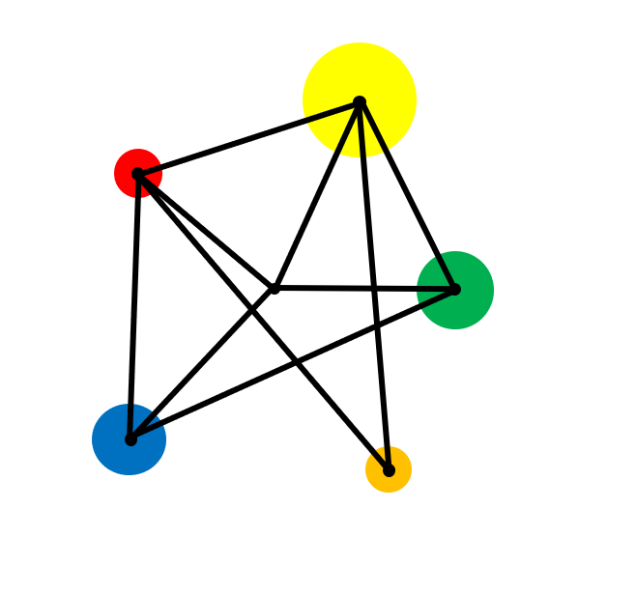
Angle Facts

Slide 2
Recap types of angle – acute, right, obtuse, reflex.
Understand angles around a point, angles on a straight line and angles in a triangle.

Slide 3
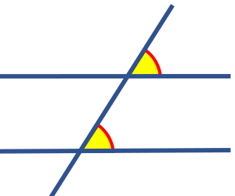
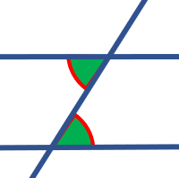
Vocabulary
Angle
A measure of turn. Usually measured in degrees.
Parallel
Lines that are always the same distance apart and never touching.
Corresponding
Angles on parallel lines that are in the same position relative to a line that crosses them.
Alternate
Angles on parallel lines that are in the opposite position relative to a line that crosses them.
Vertically Opposite
The angles opposite each other when two lines cross.
Geometry
The branch of mathematics that deals with points, lines, shapes and space.

Slide 4
Key Facts
Acute angles are less than 90º
Right angles are equal to 90º
Obtuse angles are greater than 90º but less than 180º
Reflex angles are greater than 180º

Slide 5
Types of Angle
Match each angle with its description.
Acute
Obtuse
Reflex
Right

Slide 6
Key Facts
b
i
c
f
a
e
g
h
j
d
a + b + c + d = 360º
e + f + g = 180º
h + i + j = 180º
Angles around a point add up to 360º
Angles on a straight line add up to 180º
Angles in a triangle add up to 180º

Slide 7
Examples
Find the angle marked with a letter in each diagram.
132º
b
c
51º
88º
a
72º

Slide 8
Solutions
Find the angle marked with a letter in each diagram.
132º
b
c
51º
88º
a
72º
c = 180 - 51
= 129º
a = 360 – 132 – 88 – 90
= 50º
b = 180 – 2 x 72
= 36º

Slide 9
Exercise
Find the angles marked with letters. (AB is always a straight line).
85º
B
b
55º
a
140º
c
35º
70º
A
B
A
d
4e
d
f
3e
5e
g
70º
3d
A
B

Slide 10
Solutions
b = 130º
85º
B
a = 75º
b
55º
a
c = 140º
140º
c
35º
70º
A
B
A
d = 54º
d
4e
f = 135º
g = 20º
d
f
3e
5e
g
70º
3d
A
B
3d = 162º
3e = 45º 4e = 60º 5e = 75º

Slide 11
Parallel Lines
Here are two parallel lines.
We show that they are parallel by drawing an arrow on each one.

Slide 12
Transversal
A straight line that crosses a pair of parallel lines is called a transversal.
Transversal

Slide 13
Angle Facts to learn
When a transversal is drawn, three types of angle are created.
Corresponding angles
Alternate angles
Vertically Opposite angles

Slide 14
Angle Facts to learn
Corresponding angles are equal
Alternate angles are equal
Vertically opposite angles are equal

Slide 15
Co-Interior Angles
What can you say about the pair of angles below ?

Slide 16
Co-interior Angles
Co-interior angles have a sum of 180º.
x
180 - x
x

Slide 17
Examples
Find the angles marked with a letter in each diagram.
128º
a
c
72º
b

Slide 18
Solutions
Find the angle marked with a letter in each diagram.
128º
a
72º
c
b
a = 128º
It is vertically opposite to 126º
b = 128º
It is corresponding to a.
c = 72º
It is alternate to 72º

Slide 19
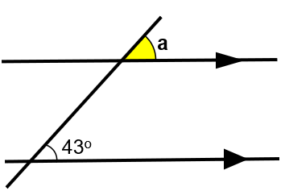
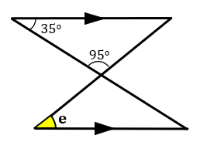
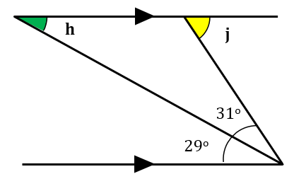
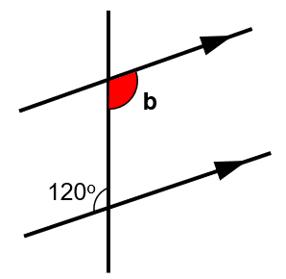
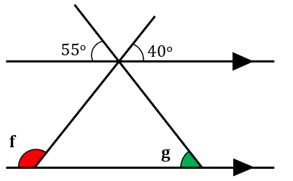
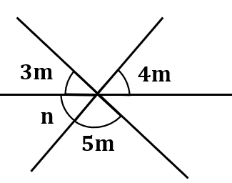
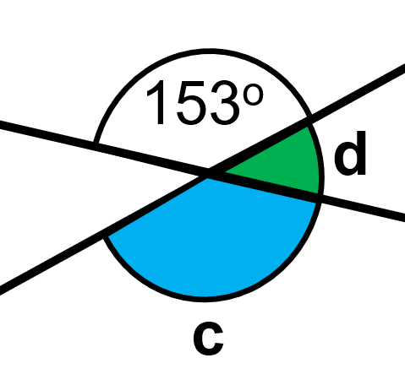
Green, Amber, Red
Find angles a, b, c and d
Find angles e, f and g
Find angles h, j, m and n

Slide 20
Solutions
Find angles a, b, c and d
Find angles e, f and g
Find angles h, j, m and n
a = 43º
h = 29º
j = 60º
e = 50º
b = 120º
3m = 45º
4m = 60º
f = 140º
n = 60º
g = 55º
5m = 75º
d = 27º
c = 153º

Slide 21
Further Exercise
Find the angles marked with letters.
a
130º
51º
c
40º
60º
f
b
d
g
h
i
j
e
50º
62º
m
n
40º
59º
k
r
l
p
o
q
s
52º

Slide 22
Further Exercise
Find the angles marked with letters.
a
a = 51º
130º
51º
c
40º
60º
c = 50º
f
b = 51º
d
g = 140º
f = 80º
j = 120º
b
d = 130º
g
e = 130º
h
i
j
e
h = 40º
i = 60º
50º
62º
m
m = 50º
n
n = 130º
r = 40º
40º
59º
p = 130º
k
r
l
p
o
s = 52º
q
s
52º
k = 59º
o = 50º
l = 62º
q = 88º

Slide 23
Extension
Draw the diagram and measure the yellow angles.
Draw the same pattern again in a different circle
Can you come up with a conjecture?
Can you prove it?

Slide 24
Exam Style Question
D
FG and HI are parallel lines.
DE is a straight line.
110º
a
F
G
c
b
a)
Write down the letter of one other angle of size 110º
Give a reason for your answer.
d
H
I
e
E
b)
Explain why a + b + c = 250º.

Slide 25
Solution
D
FG and HI are parallel lines.
DE is a straight line.
110º
a
F
G
c
b
a)
Write down the letter of one other angle of size 110º
Give a reason for your answer.
d
H
I
Angle b or angle e
e
E
b)
Explain why a + b + c = 250º.
a + b + c = 250º because the angles around a point equal 360º and 250 + 110 = 360

Slide 26
Where next?
Constructions
Geometric construction is the process of creating geometric objects using only a compass and a straightedge.
It is possible to create almost any geometric object — including circles, squares & triangles — using only these two tools
Trigonometry
This is the study of angles and sides in right angled triangles. It has been studied for hundreds of years and is useful for navigation, surveying & astronomy.
Circle Theorems
The properties of the circle have been studied beyond recorded history. The invention of the wheel is a fundamental discovery of properties of a circle.
The first known theorems about circles are by Thales of Miletus (modern day Turkey) from 650 BC. Book 3 of Euclid's Elements deals with properties of circles.

Slide 27
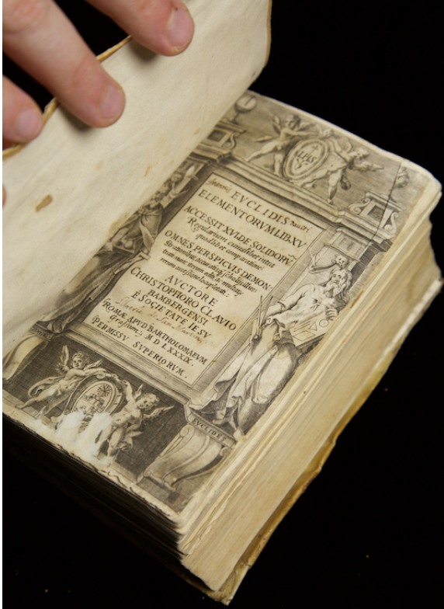
Historical links
The study of angles and geometry can be traced back over 5000 years to ancient Babylonia (modern day Iraq). The people of Babylonia started to collect facts about lines, angles, areas and volumes which helped them to advance their knowledge of surveying, building and astronomy.
The people of Eqypt and Babylon knew Pythagoras’ Theorem about 1 500 years before Pythagoras.
Euclid was born in Alexandria in Egypt in about 325 BC(c. 325-265 BC). He wrote 13 books, together called The Elements of Geometry.wrote a treatise in 13 books (chapters), titled The Elements of Geometry. This was not the first Geometry textbook but it was the best and it was widely studied in schools until the 20th Century. It contained the theorems that we saw earlier.

